Slide 1

CQC update on environmental sustainability
DCHC Registered Managers Meeting
April Cole
16 July 2024

Slide 2

CQC’s role in driving improvement in sustainability
“We’ll look at how effectively a service works with others, and in partnership with local communities, to involve people in designing and improving services.
This includes how services embed equality, diversity and inclusion, and corporate social responsibility in everything they do, such as improving local health and wellbeing, and environmental sustainability.”

Slide 3
How is environmental sustainability implemented?
Environmental sustainability will be assessed in NHS trusts (at trust level) and as part of the ICS assessments for the first year of the Single Assessment Framework (SAF).
We will not be assessing the environmental sustainability quality statement in other service types during the first year.
We will continue to develop and co-produce our approach to assessing this quality statements for other sectors prior to roll out.
We will not create a transitional score for environmental sustainability in the same way that we do for other quality statements. Environmental sustainability will only be scored when an assessment has taken place.

Slide 4
What we have been hearing from ASC
  ASC providers are aware and interested in environmental sustainability
  Frustration at the row back from Government/opposition
  What will CQC be looking for? What does good look like?
  Fear of significant costs
  Uncertainty around resources available, including training

Slide 5
What we have been hearing across all sectors
  All sectors agreed with it being added to the framework, important and essential for delivering good quality care
  Inconsistency - System not joined up on this in support, funding or engagement
  Key barriers – funding, knowledge, resources. All sectors agree that sharing good practice can overcome these
  Gentle approach and clarity around expectations. Inspector training.

Slide 6
Sustainability in the single assessment framework
Mitigation
Key Question:
Well-Led
Quality Statement:
Environmental Sustainability
Adaptation
Key Questions:
Safe and Well-Led
Quality Statements:
Safe environments
Governance, management and sustainability

Slide 7






Quality Statement (Well-led key question)
Environmental sustainability – sustainable development
We understand any negative impact of our activities on the environment, and we strive to make a positive contribution in reducing it and support people to do the same.

Slide 8
Potential Sub-topics
Quality Statement (Well-led key question)
Staff awareness and education
Carbon reduction e.g., within travel and transport, medicines, and supply chain
Health promotion and prevention.
Estates and Facilities e.g., energy saving measures, lower carbon options and recycling.

Slide 9
What are other sector accountabilities?
Green Plan
Each Trust and integrated care system (ICS) should have a green plan.
Integrated care boards (ICBs) and their partner NHS trusts, and foundation trusts have been asked to develop their first 5-year joint forward plans (JFPs) with system partners.
EPRR/Business Continuity Plan
ICBs are subject to EPRR core standards and business continuity requirements of the NHS.
Board-level 'net zero lead' responsible for overseeing its delivery.
Climate change adaption planning to be considered.
Joint Forward Plan
Include duties to contribute towards net zero targets

Slide 10
Quality Statement (Well-led key question)
People’s Experiences
Observation
Outcomes
Processes
Feedback from staff and leaders
Feedback from partners
We have defined 6 evidence categories
Not all categories will be required for all quality statements
Evidence categories will be assigned a score on a 4-point scale for each quality statement (where they apply)

Slide 11
Things to think about
    Are people using services aware and able to engage in planning?
    Considering options to optimize medicine use and reduce waste.
    Are staff being encouraged and enabled to consider sustainable practices? For example, cycling to work schemes.
    Adapting and changing pathways – especially remote and digital
      Consider the co-benefits for the community – working with local partners

Slide 12
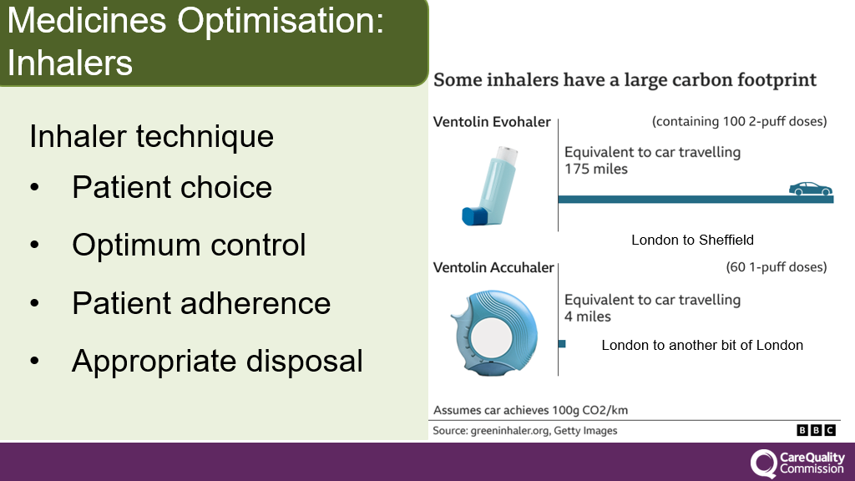
Example of medicines optimisation: Asthma Inhalers

Slide 13
What could good look like in adult social care?
    Leadership demonstrates a commitment to environmental sustainability. There is appropriate governance and support, with a named staff member considering net-zero targets and Green Plan.
    The provider can demonstrate that it has taken reasonable steps to minimise adverse impact of climate change on health.
    The provider makes its workforce aware of their individual carbon footprint in the context of their role and enables and supports them to reduce this.
DRAFT

Slide 14
Questions for discussion
How can CQC work with you to encourage improvement in sustainability?
What does good look like for adult social care? Have you any examples of changes you have made, or plan to make, to improve sustainability?

Slide 15








CQC resources available
Provider Bulletin
https://www.cqc.org.uk/news/newsletters-alerts/email-newsletters-cqc or Search: CQC bulletin
Publications
https://www.cqc.org.uk/publications
Social
@CQCProf @CQCProf
youtube.com/user/cqcdigitalcomms
facebook.com/CareQualityCommission
CQC is changing – YouTube playlist
https://youtube.com/playlist?list=PLEwLzOd_XW-IU-FCX2gvNu3OYG1aHn365
Digital platform
https://cqc.citizenlab.co/en-GB/ or Search: Citizenlab CQC
Podcasts
Wherever you listen to podcasts
Search: CQC Connect
Blogs
https://medium.com/@CareQualityComm
or Search: Medium CQC

Slide 16

Thank you
April.Cole@cqc.org.uk

