Slide 1
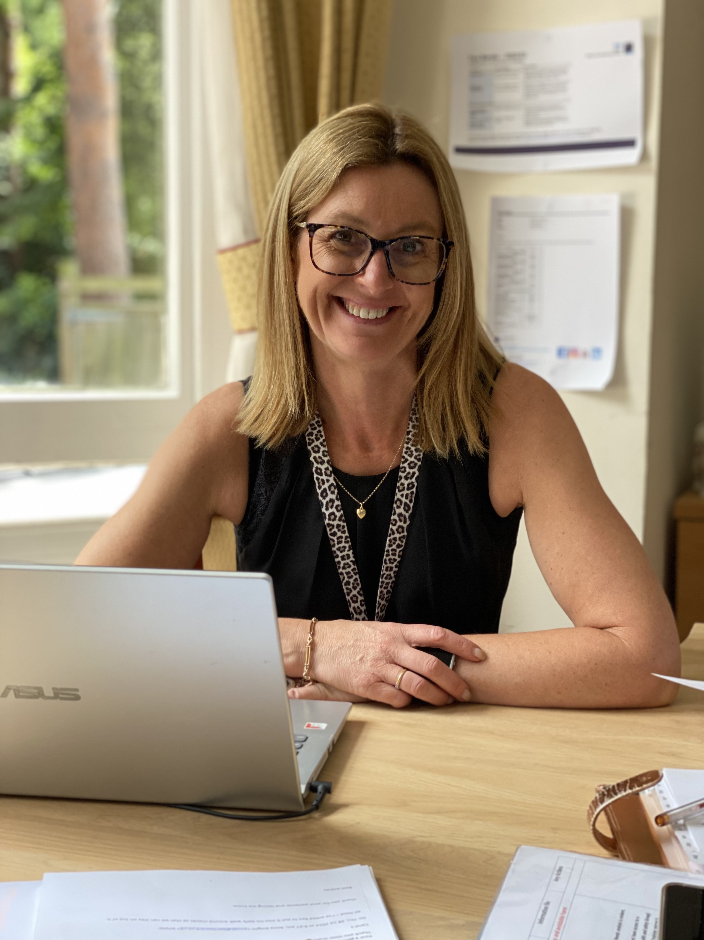

Caring in the Community – Valuable Insights into the modern care industry and the challenges that it faces.
Anna Knight, CMgr FCMI
Development Lead

Slide 2

Single
Assessment Framework
Significant Changes:
Inspection and rating methodology
Information and intelligence gathering to support CQC Judgements
Assessments triggered at points using 2-year schedule of activity
Rating is not the main driver!
Factual accuracy
CQC Inspector roles have changed – no relationship building/ownership status
Don’t spend any money implementing systems yet!

Slide 3



EVIDENCE
Off Site (Primary)
On Site (Secondary)
Different Ways
Different Times
Gather evidence from a wide variety of sources
Use any number of quality statements.
One, several or ALL used.
Evidence categories bring structure and consistency to their approach.
Resulting in final score.

Slide 4
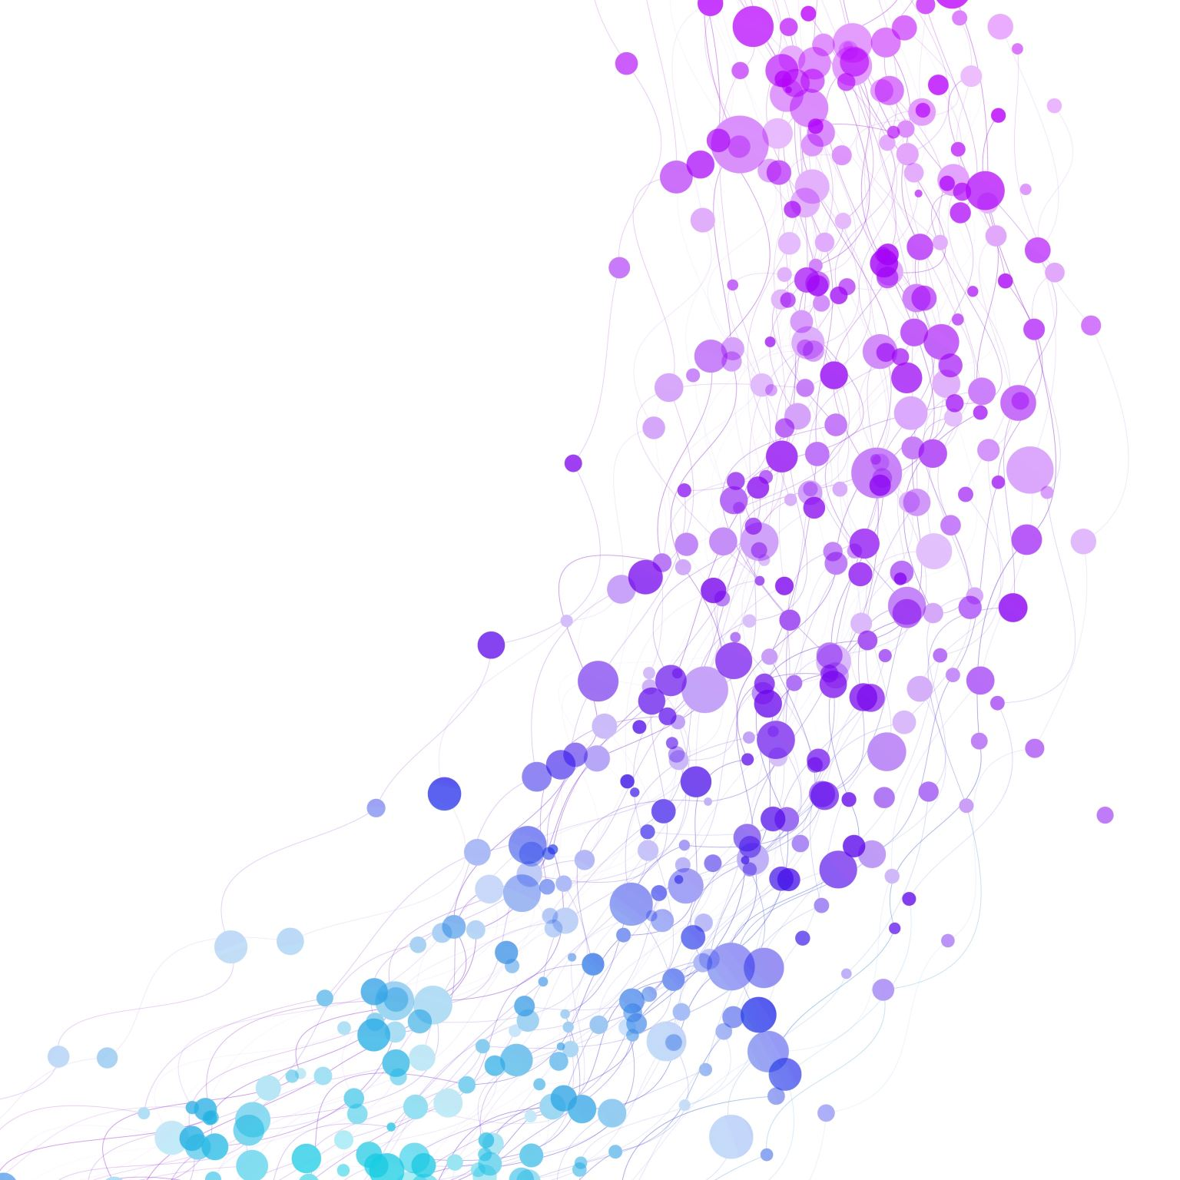
CQC
CARE HOME FOCUS
* People’s experiences
* Feedback from Staff and Leaders
* Observation, Monitoring, Lessons Learned
* Processes (existing and new with reasoning)
* Compliance
* CQC working knowledge amongst team

Slide 5
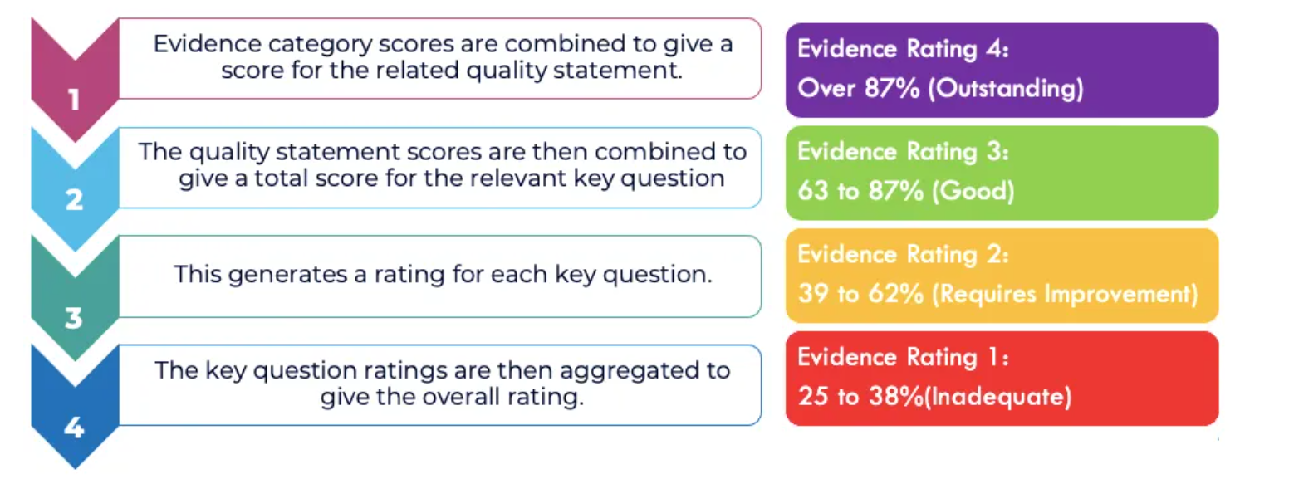
What do I need to know?

Slide 6

SCORING
* Evidence types are reviewed.
* Score applied to each category.
* Evidence category scores combined to give score for related quality statement.
* Quality statement scores combined to give total score for relevant key question.
* Score generates a rating for each key question.
* Total the key question ratings to give overall rating.
Ratings will be published first.
Scores will not be published initially.

Slide 7

The way to get started is to quit talking and begin doing.
Walt Disney

Slide 8

Summary
Do not spend any money on implementing systems or employing staff YET!
Ensure more than one person has access to the portal! PIR’s MUST be returned without delay.
Ensure ALL your staff know how evidence is gathered and keep surveying EVERYONE!
Collaboration, Communication, Co-Production and Continuity. Good Luck!

