Slide 1



Slide 2
The Devon and Cornwall Care Record brings together patient data from a number of health and social care providers and presents it as a single record.
Hospitals
GPs
Care Homes
Hospices
Pharmacies
Social Care
Private hospitals
Opticians
And many more!

Slide 3
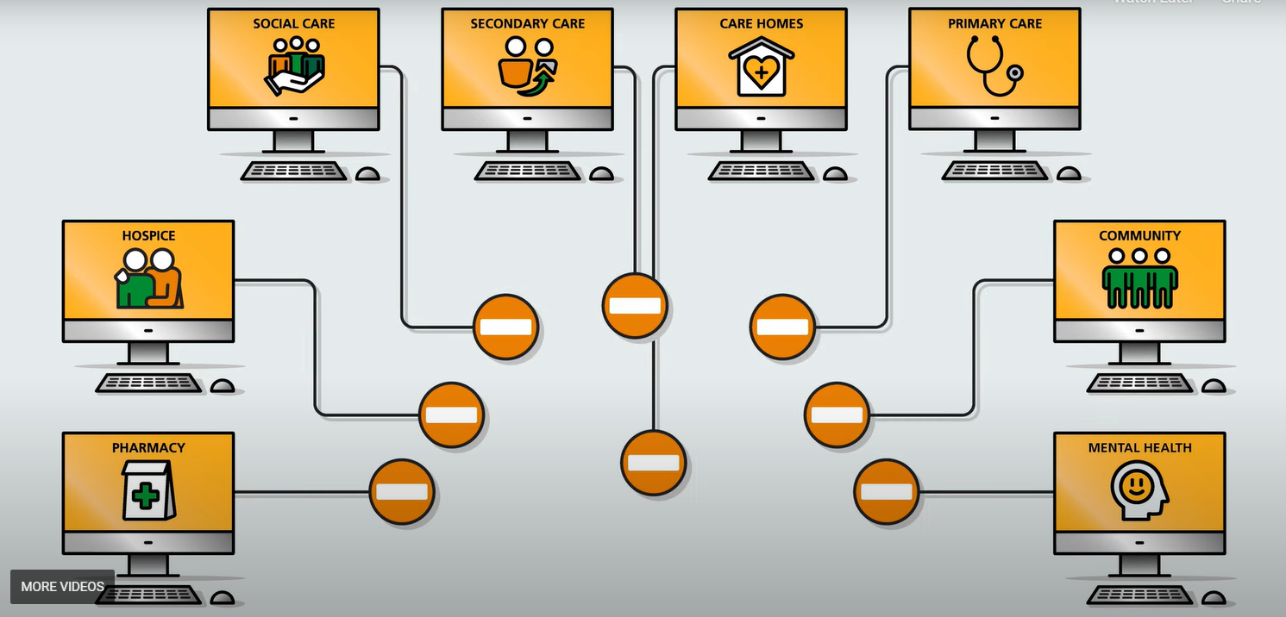
Notes:
Systems connected together would be a bad idea

Slide 4
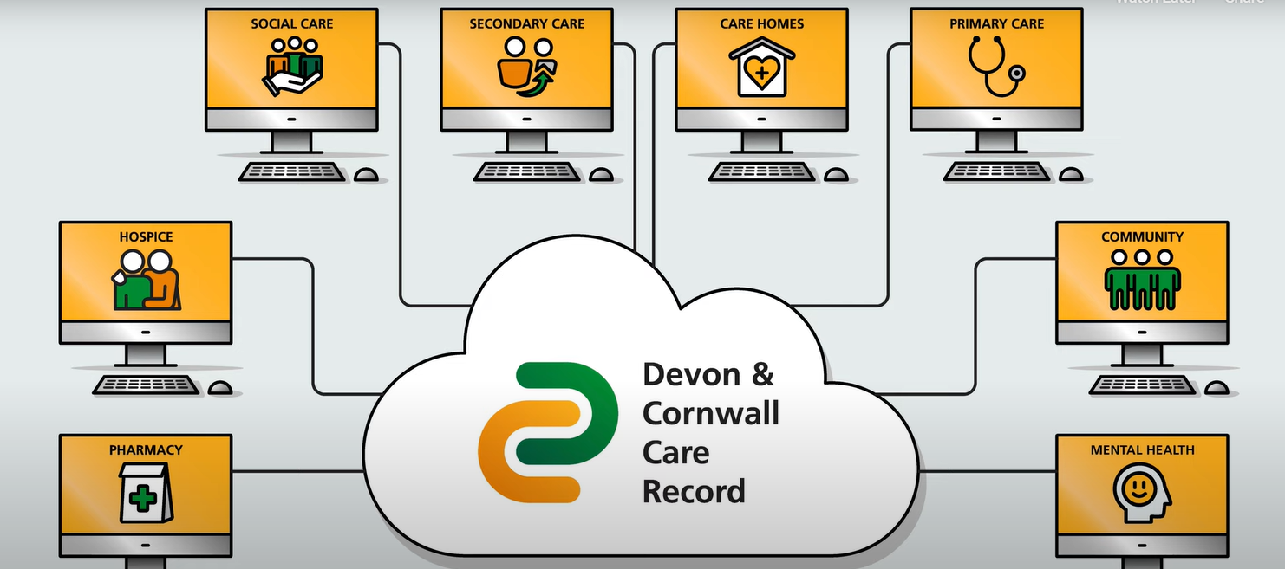

Slide 5
The DCCR is implemented by a project board run out of the Integrated Care System that includes all major stakeholders.
It consists of 1 full time programme manager, part time IG support and the support team hosted by CITS.
Notes:
funded

Slide 6
The DCCR currently receives data from:
GP Data 56 of 56 Cornwall
85 of 121 Devon
RCHT Admission, discharge, and Transfer (ADT) information
Emergency Department (ED) Attendances
Outpatient appointments, attendances, and cancellations
Range of Documents (including echocardiograms)
Range of Alerts including autism & learning disabilities flags
Devon Hospices Clinical Record
CFT ADT information
Outpatient appointments, attendances, and cancellations
UHP ADT information
Outpatient appointments, attendances, and cancellations
DPT IAPTUS data
Livewell Clinical Record (from SystmOne)
Notes:
And this is increasing all the time

Slide 7
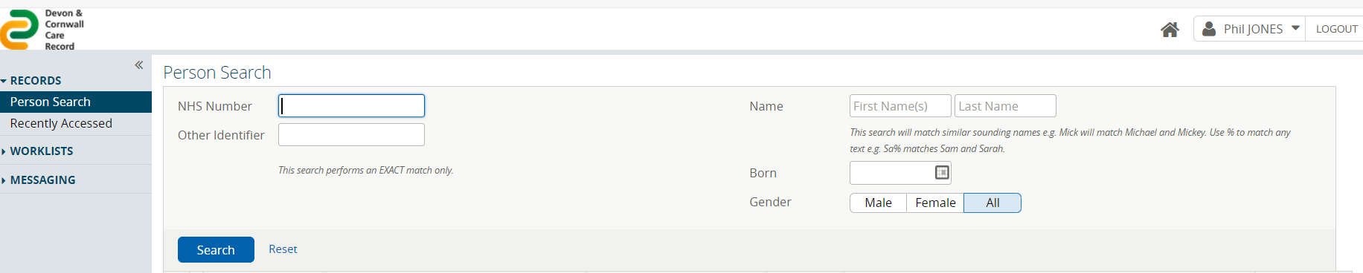
Notes:
LIC vs portal

Slide 8
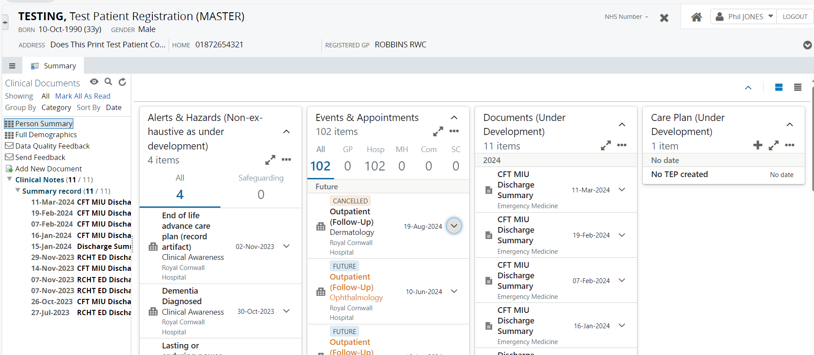

Slide 9
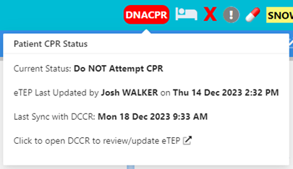
Electronic Treatment Escalation Plan (eTEP)
Went live in Plymouth and South-West Devon in February
First part of the DCCR that wasn’t reading from elsewhere
Single source of truth
Mandatory fields

Slide 10
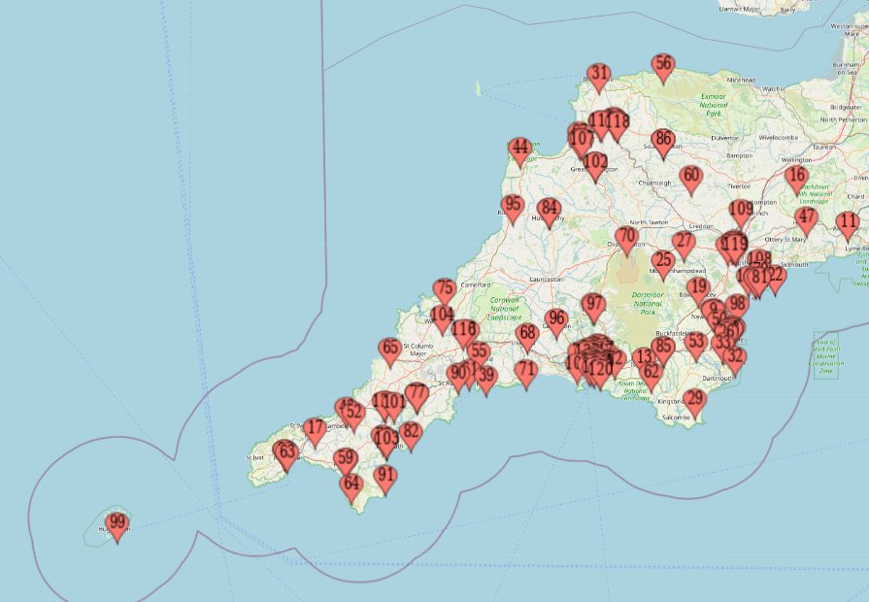
The DCCR as of today:
18574 registered users
5000 eTEPs
Notes:
More even outside of the devon and cornwall

Slide 11
The DCCR in the next 6 months:
5000+ Users from CFT
2000+ from DPT
10,000+ from RDUH
Roll out of eTEPs in the rest of Devon and South East
Cornwall

Slide 12

The DCCR after that:
NRL access
Joining other SCR
NHS App data sharing
Continued expansion…

