Slide 1

11 Plantation Terrace, Dawlish, Devon
Tel: 01626 868190

Slide 2
What is Eden?
Probably the best culture transformation programme in the world.
Straight forward
Cost effective
Proven over 30 years

Slide 3
What does Eden comprise?
Shares and promotes your values
Embraces 7 Domains of wellbeing, and
Adopts 1o Principles

Slide 4
Why do it?
Strengthen:
Developing Team wellbeing and passion
Fulfilled team = Great retention
Collaborative teamwork and innovation
Reputation / Compliance / Occupancy / Viability
Resident fulfillment

Slide 5
Geoffrey Cox, MSc. LLb Hons
CEO of Eden Alternative UK
MD of Southern Healthcare, 4 Devon Nursing Homes
24 years in Social Care
MSc Dementia Studies
Board member of the NCA/RNHA
Director of Devon Care Homes Collaborative
Member of Reinventing Social Care team

Slide 6
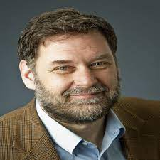
Dr Bill Thomas
US Geriatrician
Co-Founder of Eden Alternative
Evolved after GP support to a New York Care Home
He identified some challenges, especially:
Loneliness, Helplessness and Boredom
Eden Alternative was created as a solution
Focus on the wellbeing of everyone in the ‘care partnership’

Slide 7
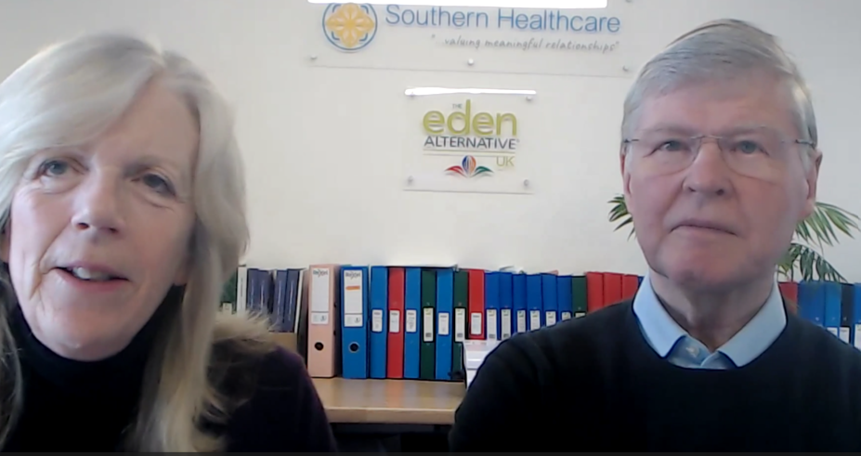

Eden – How?
Online learning
7 weekly sessions
1 hour per week live learning
Supplemental reading
Reference Videos
11am Thursdays
Courses start on the 1st Thursday of every ‘uneven’ month (Jan, Mar, May etc..)
Next start date: 1st May 2024

Slide 8
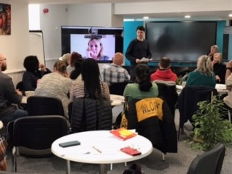
Eden – How?
In-person learning
2-day in person courses
Interactive learning
Group discussions
Videos
Cross pollination of care experiences
Well-accommodated training venue in Dawlish, Devon
Accommodation available on-site
Next date: 29th & 30th April 2025

Slide 9

The 7 Eden Domains of Wellbeing
Identity
Growth
Security
Connectedness
Autonomy
Meaning
Joy

Slide 10
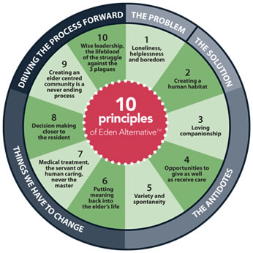
The 10 Key Eden Principles
The Problem Statement
The Solution Statement
Addressing Loneliness; with loving companionship
Addressing Helplessness; with building care partnerships
Addressing Boredom; with spontaneity & joy
Meaningful engagement
De-medicalisation
Empowerment
Sustainability of innovation
Modern Leadership principles

Slide 11

Contact details
Email: enquiries@eden-alternative.co.uk
Tel: 01626 868190 or 07843 359472
Website: eden-alternative.co.uk
Or, visit us today at our stand

