Slide 1
Identifying Pain in Dementia
And the use of PAINAD.
Lucy Hernaman
Registered Nurse
Heanton Nursing Home

Slide 2
Studies suggest that pain is under-recognized and under-treated in those with severe dementia.
Often a persons behaviours are misinterpreted as physical or verbal aggression.
Identifying pain is the first step in its effective management.

Slide 3
What is PAINAD
PAINAD is an assessment method used to determine if a Family member could be in pain by observing them for a period of 5 Minutes
The family member can be observed doing various activities such as personal care, resting, occupation or activity.
A scoring system is then used to determine what level of pain that Family member may be suffering with.
It is not a fail safe and it is important to remember that we need to consider other conditions too. Such as UTI, Constipation etc.

Slide 4
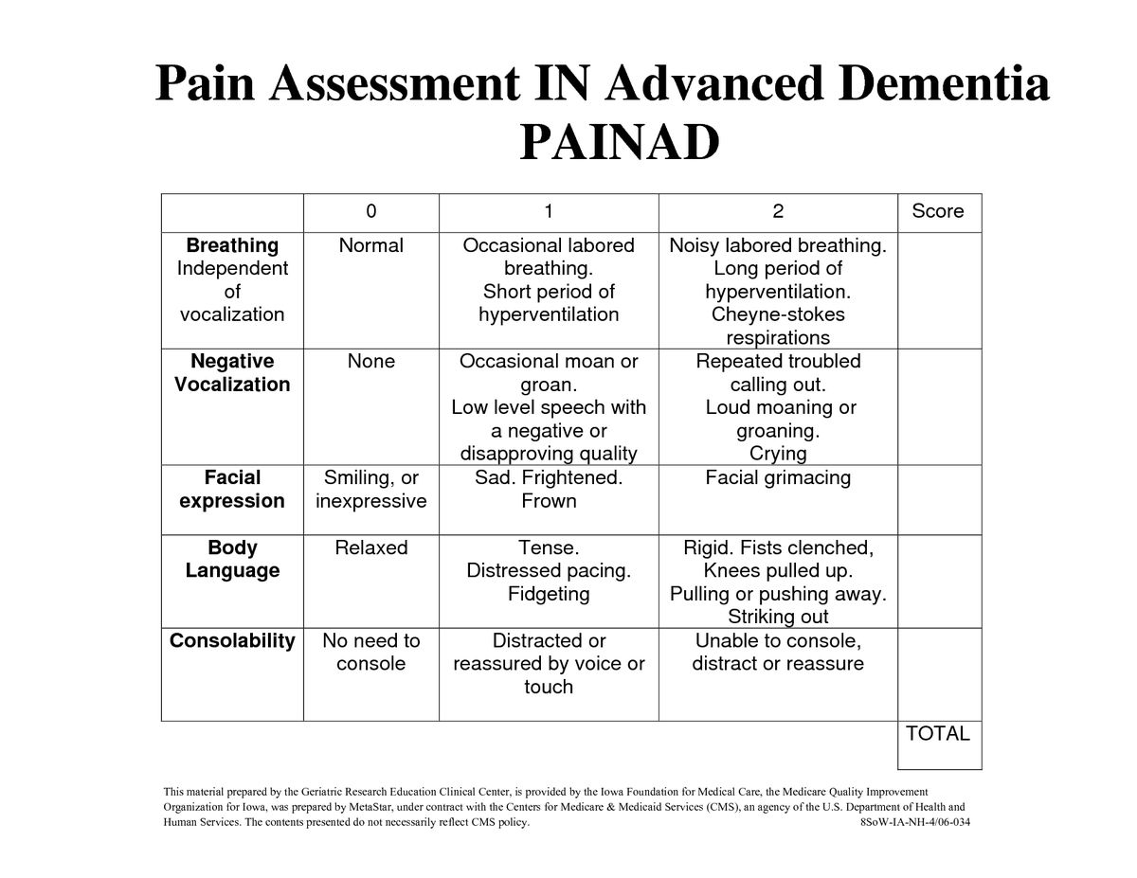

Slide 5
BREATHING.
Normal breathing is characterized by effortless, quiet, rhythmic (smooth) respirations.
Occasional laboured breathing is characterized by episodic bursts of harsh, difficult, or wearing respirations.
Short period of hyperventilation is characterized by intervals of rapid, deep breaths lasting a short period of time.
Noisy laboured breathing is characterized by negative-sounding respirations on inspiration or expiration. They may be loud, gurgling, wheezing. They appear strenuous or wearing.
Long period of hyperventilation is characterized by an excessive rate and depth of respirations lasting a considerable time.
Cheyne-Stokes respirations are characterized by rhythmic waxing and waning of breathing from very deep to shallow respirations with periods of apnoea (cessation of breathing).
Group A
Task 1
Task 2
Group B
k 1
Task 2
Group C

Slide 6
NEGATIVE VOCALISATION.
None is characterized by speech or vocalization that has a neutral or pleasant quality.
Occasional moan or groan is characterized by mournful or murmuring sounds, wails, or laments. Groaning is characterized by louder than usual inarticulate involuntary sounds, often abruptly beginning and ending.
Low level speech with a negative or disapproving quality is characterized by muttering, mumbling, whining, grumbling, or swearing in a low volume with a complaining, sarcastic, or caustic tone.
Repeated troubled calling out is characterized by phrases or words being used over and over in a tone that suggests anxiety, uneasiness, or distress.
Loud moaning or groaning is characterized by mournful or murmuring sounds, wails, or laments in much louder than usual volume. Loud groaning is characterized by louder than usual inarticulate involuntary sounds, often abruptly beginning and ending.
Crying is characterized by an utterance of emotion accompanied by tears. There may be sobbing or quiet weeping.

Slide 7
FACIAL EXPRESSION
Smiling or inexpressive. Smiling is characterized by upturned corners of the mouth, brightening of the eyes, and a look of pleasure or contentment. Inexpressive refers to a neutral, at ease, relaxed, or blank look.
Sad is characterized by an unhappy, lonesome, sorrowful, or dejected look. There may be tears in the eyes.
Frightened is characterized by a look of fear, alarm, or heightened anxiety. Eyes appear wide open.
Frown is characterized by a downward turn of the corners of the mouth. Increased facial wrinkling in the forehead and around the mouth may appear.
Facial grimacing is characterized by a distorted, distressed look. The brow is more wrinkled, as is the area around the mouth. Eyes may be squeezed shut.

Slide 8
BODY LANGUAGE
Relaxed is characterized by a calm, restful, mellow appearance. The person seems to be taking it easy.
Tense is characterized by a strained, apprehensive, or worried appearance. The jaw may be clenched. (Exclude any contractures.)
Distressed pacing is characterized by activity that seems unsettled. There may be a fearful, worried, or disturbed element present. The rate may be faster or slower.
Fidgeting is characterized by restless movement. Squirming about or wiggling in the chair may occur. The person might be hitching a chair across the room. Repetitive touching, tugging, or rubbing body parts can also be observed.
Rigid is characterized by stiffening of the body. The arms and/or legs are tight and inflexible. The trunk may appear straight and unyielding. (Exclude any contractures.)
Fists clenched is characterized by tightly closed hands. They may be opened and closed repeatedly or held tightly shut.
Knees pulled up is characterized by flexing the legs and drawing the knees up toward the chest. An overall troubled appearance. (Exclude any contractures.)
Pulling or pushing away is characterized by resistiveness upon approach or to care. The person is trying to escape by yanking or wrenching him- or herself free or shoving you away.
Striking out is characterized by hitting, kicking, grabbing, punching, biting, or other form of personal assault.

Slide 9
CONSOLABILITY
No need to console is characterized by a sense of well-being. The person appears content.
Distracted or reassured by voice or touch is characterized by a disruption in the behaviour when the person is spoken to or touched. The behaviour stops during the period of interaction, with no indication that the person is at all distressed.
Unable to console, distract, or reassure is characterized by the inability to soothe the person or stop a behaviour with words or actions. No amount of comforting, verbal or physical, will alleviate the behaviour.

Slide 10
What Scores to give:

Slide 11
SCORING YOUR PAINAD:
When documenting each domain should be documented and then a score given. As well as an explanation as to how that person displays those signs. This will help to build up a picture for you and future healthcare workers for easier identification.
Breathing – 1 some laboured breathing.
Vocalisation – 2 crying out loud, calling for Son.
Facial expression – 2 scrunched up facial features and grinding teeth
Body language – 1 holding self awkwardly, left side particularly
Consolability – 1 able to reassure with a lot of staff 1:1 time. But only for short periods.
Score 7 total. SEVERE PAIN. Consider PRN

Slide 12
What does the scores mean?
The total score ranges from 0-10 points.
The scores could therefore possibly indicate:
- 1-3=mild pain
- 4-6=moderate pain
- 7-10=severe pain
Medication can then be given with good rationale and reason.

