Slide 1
Posture Care for Carers
Resources and support from the Independent Living Centre

Slide 2



Devon Independent Living Centre
NHS Therapists
Website resources
Equipment advice and assessment
Training
Free service for people in Devon
Notes:
Show of hands- who has heard of the Independent Living Centre?
Joint funded service DCC/NHS staffed by NHS OTs and PT
Our job is to keep up to date about equipment solutions > work closely with national equipment suppliers and local retailers, and reviewing equipment so we can make informed recommendations
Centre equipped with variety of equipment > mobility, beds, chairs, bathroom, kitchen, dressing, adaptations. People can book a face to face appointment with us to try equipment and have independent advise. I like to think of us as the stop before the shop. We don’t sell anything, we are there for impartial advise and information. Avoid being caught out by salesperson.
Assessment and advice for anyone in Devon- in centre, by phone, by email- please use us.
Website of resources inc specific section for care providers which I will show you later
Providing training for Devon teams- the main purpose of the reason for coming to see you today is to share some training and resources we have developed on posture care, aimed at carers, which we have developed alongside a care home, Mapleton.

Slide 3
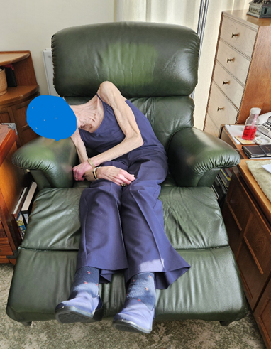
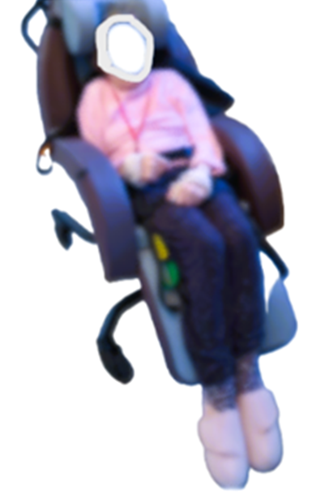
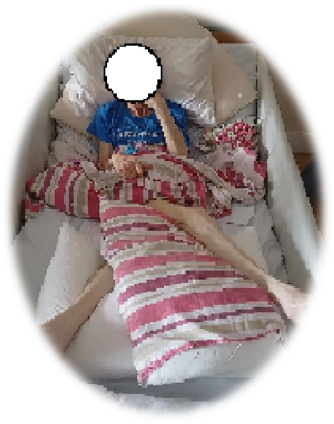
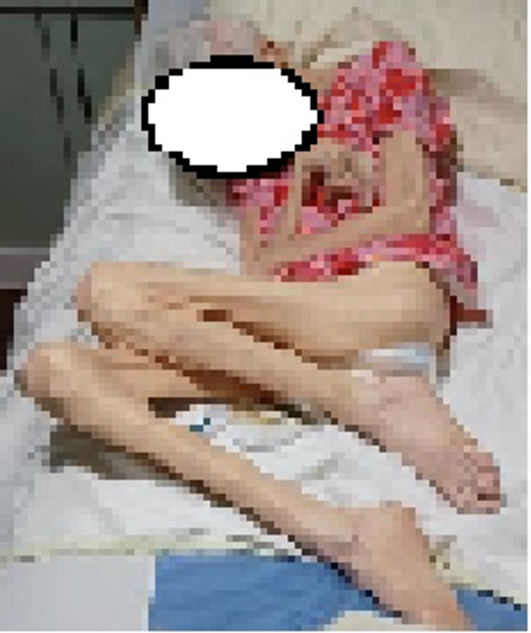
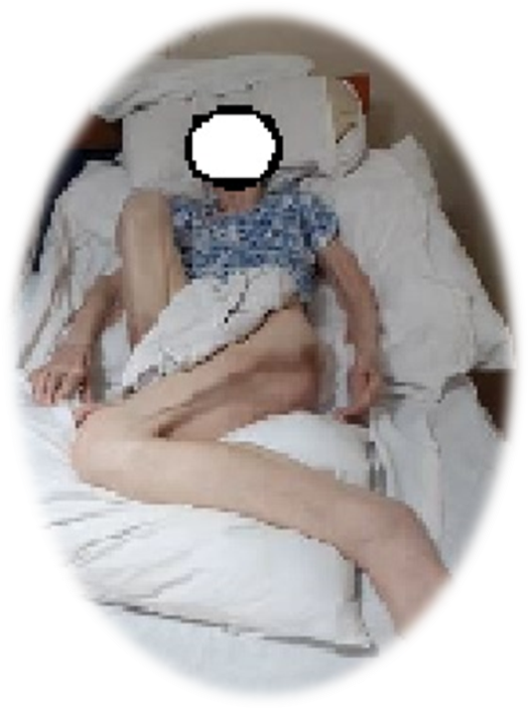
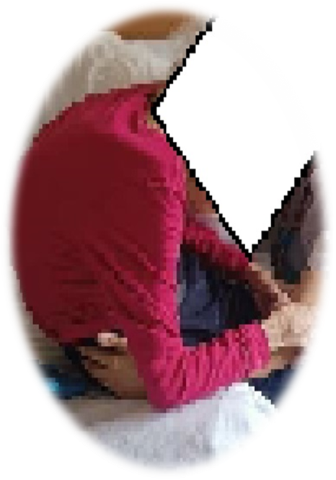
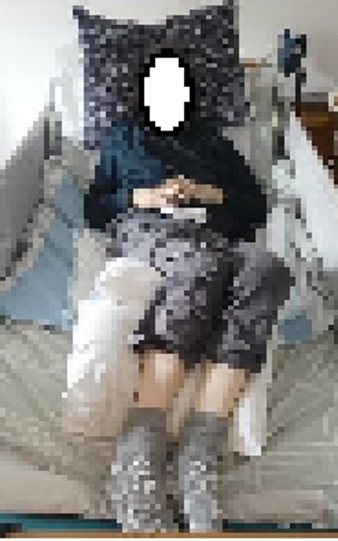
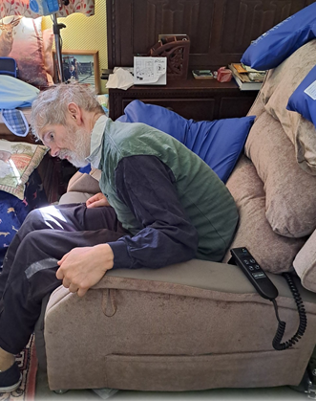
A familiar sight…
Notes:
Before we do- I want to give you some background on the motivation behind the posture care training and resources we have developed.
Firstly, if anyone would like to volunteer to take part- I would like you to sit in an awkward position in your chairs, for example, leaning forward, in a slumped position or leaning to the side, until the end of this slide.
The lady you see in the photo was referred to us by a community therapist who was at a loss as to how to support this lady. She was living in a care home, with advanced dementia and is non verbal. She had been sleeping in a foetal position and had been contracted for a while but this has become progressively worse, and as you can see from her position, her arms and legs are extremely tight and unable to straighten out. Her head is extremely forward flexed and overtime has become fixed in this position. She was no longer able to sit out in a chair due to the position of her legs and head. This posture was causing a lot of difficulty for carers in providing care.
This is not an isolated case (click to reveal more photos)
– this chap has what we call ‘kissing knees’ where his legs are completely crossed over
-these individuals are at different stages of their legs becoming contracted from sweeping to one side.
This lady is slumped and side leaning in her chair, which led to changes in the shape of her spine
This lady was initially seen by us 2 years prior to this photograph and given advise on suitable seating. Unfortunately she chose to remain sitting in her favourite upright chair which was not a good fit, and 2 years later she was cared for in bed as her posture had deteriorated so much
this chap is slumping heavily to the side and no longer able to sit upright after years of sitting in an unsupportive chair
This person is in a slumped position due to the chair not being adjustable for their size and shape, and without foot support, leaving them at risk of falls
we have seen a huge increase in queries coming to us from both the care sector, therapy teams and nursing staff working with individuals in a similar situation . Show of hands who has seen someone with a similar posture.
Some of you have been sitting in difficult positions for a while- how are you feeling? This is after only a few minutes of poor posture- you can sit comfortably again now. For people like us, where we can move independently and change positions when we feel uncomfortable, these postures on their own are not an issue. However, for people with health conditions who lack independent movement, and rely on us to move them, they can cause widespread problems.
What would be the consequences of sitting or lying in these positions for long periods- both for care staff and for the person themselves? Audience to add to chat
Pain
Reduced function
Difficulty communicating
Pressure ulcers
Depression
Low self esteem
Social exclusion
Care burden
Poor sleep
Difficulty breathing
Problems with eating, drinking and digestion
Difficulty moving
Difficulty supporting with personal care
Constipation

Slide 4
Who is at risk
Anyone who has difficulty with moving independently
2. People who are chair or bedbound
3. People with certain diseases/conditions
dementia
neurological conditions
joint conditions, fractures, pain
Notes:
Many of us can adjust our position if we begin to feel uncomfortable, experience pain or recognise our position could be harmful. However, there are certain people who are more at risk of posture changes…
This includes…
- Anyone who has difficulty moving independently and people who are bed or chair bound are at very high risk
When we have a movement difficulty caused by an injury, disability or age it becomes more difficult to freely adjust our position. Our body will move in less symmetrical movement patterns leading to a weakness and asymmetry of different parts of the body. They will often sit and lie in a limited number of positions, sometimes relying on others to move them out of these positions. Gravity will compound this effect – pulling the body & limbs further into poor posture, and sometimes into un natural positions which can result in dislocation or misalignment of joints.
Staying in a limited number of positions reduces the range of movement available in the joints and causes changes to muscle length.
-Certain diseases or conditions also increase the risk of movement difficulties, and therefore body shape changes e.g. neurological conditions like MS and Parkinsons, joint conditions such as arthritis or fractures, pain, fatigue syndromes and dementia, which we will talk in more detail about later.
It is important to understand just how distorted someone’s body shape can become if the correct interventions are not put in place. This distortion can have a life threatening and life limiting impact.

Slide 5
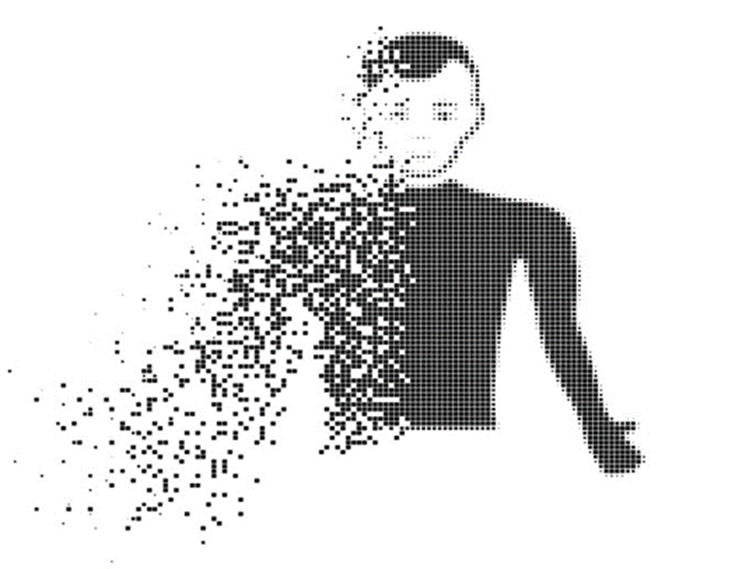
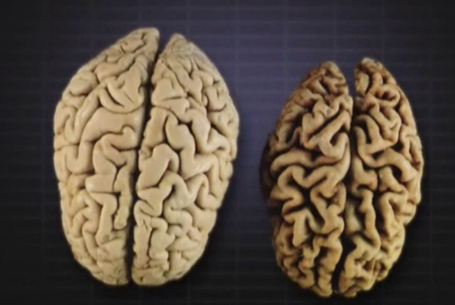
Dementia
Picture from dementiacarecentral.com
Notes:
People with dementia are at particularly high risk of posture change,
The photo shows a photo of a normal brain on the left compared to a brain of someone living with Alzheimer's dementia on the right
We can see that brain mass is significantly reduced in the diseased brain. The loss of brain tissue is widespread and effects many parts of the brain, including the areas that regulate muscle tone (the amount of tension held in a muscle) and the sensory system.
As a result we see changes in how the person holds their posture and processes sensory stimulus.
80% of people living with advanced dementia will experience involuntary increased muscle tone triggered by:
being touched or moved by carers/family
gravity pulling the person’s body in a downward direction
Paratonia can also cause posture changes over time.
equipment that moves the person such as standing hoists or rise recline chairs
This response is known as paratonia. A person with paratonia may be more rigid and difficult to move.
Earlier signs - may be more subtle like loss of ability to fully straighten legs or arms, curling up in lying and crossing legs over in chair and hugging themselves, tensing up when being handling /helped out of a chair.
In later stages- paratonia can cause the person to hold themselves in tense/flexed positions and lead to posture changes over time as seen in the photos.
Dementia also affects the part of the brain responsible for processing information from our senses. As a result, someone may lose the ability to feel their body, or to know where their body is. They may feel like they are disintegrating as shown in the picture. The loss of ability to know where there body is, can also make them more anxious when being moved by carers
In earlier stages of dementia sensory loss may present as having difficulty with other tasks such as eating and drinking, or walking, as the person can no longer feel their hands or feet very well. They may also demonstrate such as repeated chewing, repetitive movements, restlessness to compensate.
In later stages ,sensory loss can contribute to them to curling up and adopting flexed postures to help them feel safer, which can result in fixed foetal positions

Slide 6

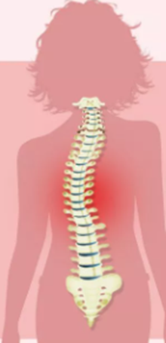
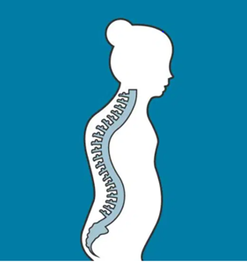
Some good news…
Posture change is preventable!
Notes:
If we can recognise who is at risk and provide them with support at the earliest stage of their disease, when they start to have movement difficulties or mild posture changes, we can prevent posture changes from occurring.
Care providers are really key to preventing posture change as you are seeing people for many years and know them really well. You might have noticed that the community therapists are talking more about posture, as they have received a lot of training in this area, and there are things we know about now that we didn’t know a few years ago, so we are now trying to spread the word so we can work more preventatively.
Part of the reason for the shift in our understanding is we have been learning more about the work of world renowned physio, Jo de clercq, who’s pioneering approach has changed the way therapists and carers are thinking about posture care. He runs a dementia care facility in Belgium, where the approach he is using has completely eliminated contractures and pressure injury in over 10 years. There is a lot of interest in his approach and teams in the UK including us in Devon, are starting to implement it in our services and build clinical evidence around using it.

Slide 7
Care Home Resource Pack
2 Part Video Series
Handout: Supporting Posture in Dementia
Website guides
Notes:
This new learning has lead to us developing a care home resource pack. I have to give a shout out at this point to Viola at Mapleton dementia care home in newton abbot, who has given us lots of support and feedback throughout the development process to ensure the materials are relevant and practical for carers to follow.
The first part of the training is a 2 part video series on Posture- aimed to be ‘bitesize’ so you can use them in meetings and fit them into busy schedules, rather than attending a lengthy training session. It has a mixture of videos and graphics to suit different learning styles.
Video 1- Introduction to Posture – 20 mins, about identifying people at risk and the consequences of posture change
Video 2- Posture Care for Carers- 25 mins- includes information to help them make simple, practical changes to support someones posture in sitting standing and lying. It his designed to focus on the things they can do easily using things they have access to it the workplace such as pillows, or re-arranging where the persons table/TV is positioned which can have a huge positive lasting impact. It also talks about equipment selection, and for people with more complex needs, and knowing when to ask for help.
Ask if Viola has anything to add.
Part 2 is a handout, supporting posture in dementia which goes hand in hand with the training, but is a resource to highlight the specific issues in dementia, and helps to explain to families why we might be doing what we are doing with the person.
I can show you this on our website, along with our other guides

Slide 8
www.independentlivingcentre.org.uk
Notes:
Show BYB guide, supporting posture in dementia, retailer lists

Slide 9

Contact Us…

