Slide 1


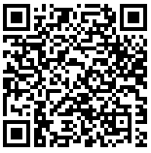
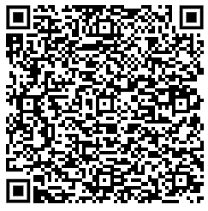
Key contacts for Care Homes - Updated April 2024
In Hours Contacts
Community Crisis Response
Palliative Care – St Lukes Hospice Care
Livewell Referral Support Services (LRSS)
CCRT referrals accepted 8am-6pm 7 days
Acute Response Practitioners Referrals accepted 9am-3pm Monday - Friday
All hospice patient referrals accessed via a single number
9am to 5pm
The direct gateway for advice, referral and triage co-ordination
Signposting, advice and guidance, small equipment provision/POC adjustments
Onward referral for face-to-face assessment/review of needs determined by complexity of situation post triage
Email: livewell.therapyreferrals@nhs.net
01752 964200
01752 437777 Option 6
District Nursing
To contact your District Nurse between 8:30am - 5pm, Monday - Friday please see telephone numbers below:
Care Home Liaison Service
Single point of contact for care homes
Aligned core community workers
Tel: 01752 434267
Email:
livewell.carehomeliaisonservice@nhs.net
North Tel: 01752 436716
East Tel: 01752 434546
South Tel: 01752 434851
West Tel: 01752 434423
Scan for link to Adult social care referral form
Discharge to Assess
Phlebotomy: 01752 435246
For people who have been discharged from hospital into a care home via DTA
Continence: 01752 434759
01752 982228 (8am – 6pm) or email: mayflowerDTA@econsultforhealth.net
Community District Nursing: 01752 434629
Plymouth Community Equipment Service
Speech and Language Therapy: livewell.therapyreferrals@nhs.net
For queries around equipment, please use the contact details below:
Community Infection Management Service contact details 01752 432115 plh-tr.IPCT-Admin@nhs.net
0800 9887344 or email enquiries@plymouth.nrs-uk.net
Out Of Hours Contacts
Safeguarding
Out Of Hours GP Service
District Nursing
Safeguarding Adults Single point of Access. Scan QR code to take you to referral form.
For out of hours, weekends
or bank holiday District Nursing calls, please call the Single point of access below:
111 (*6 to get through to a dedicated care home line)
111
01392 269475
01752 668000
Remember! Access to Treatment Escalation Plans are through Devon and Cornwall Shared Care Record
For more information contact: rcht.dccrsupport@nhs.net
Quality Assurance and Improvement Team (Plymouth City Council)
The QAIT mailbox will close on 14 April 2024,
Alternate emaii: jointcommissioning@plymouth.gov.uk

