Slide 1
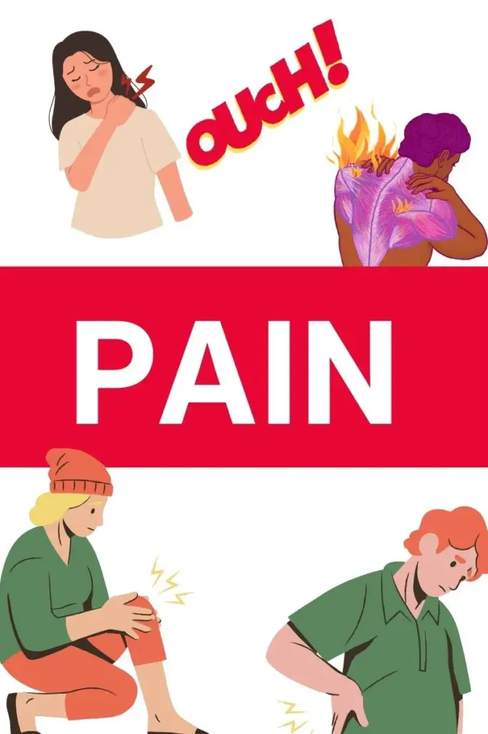
Pain Recognition Tools in Social Care

Slide 2
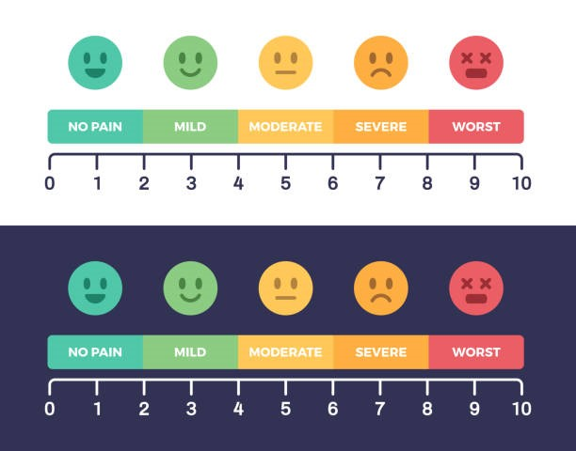
Numeric Rating Scale
This is the gold standard of pain assessment in those who can self-report pain.
The resident rates the intensity of their pain on a scale of 0 to 10, with 0 being no pain and 10 being the worst pain imaginable.

Slide 3
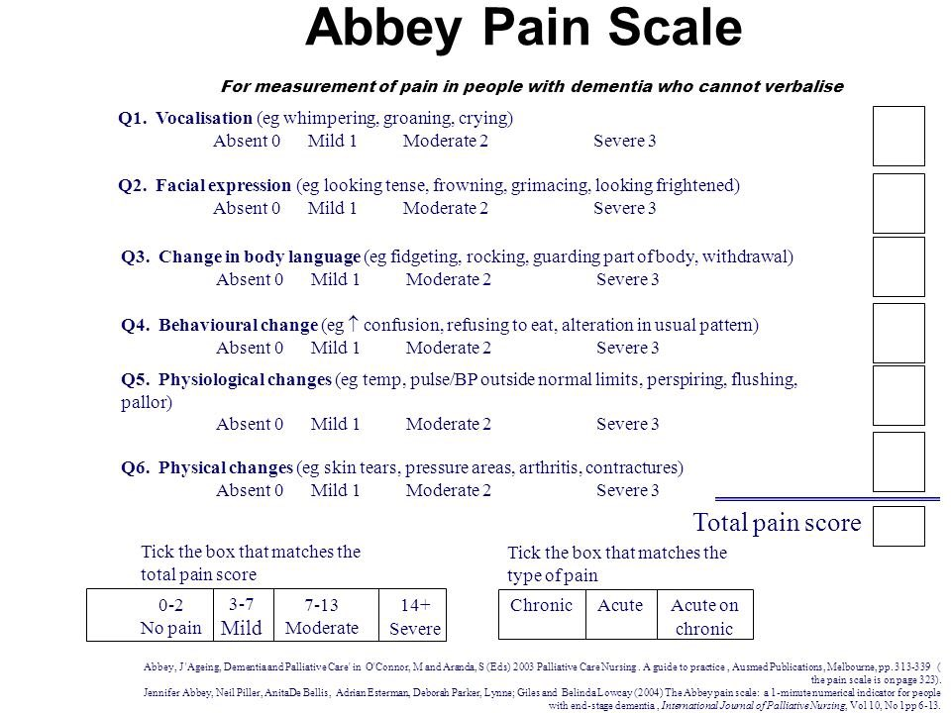
This is an observational tool where users observe the resident in six key areas: with each area given a rating.
Once all observations have been made, the user adds up the score and the resulting number indicates the intensity of the resident’s pain before deciding on appropriate treatment/action

Slide 4
Important PAIN reminders:
Pain can be subjective and is often under assessed and unrelieved
Assessment in social care can be complex, pain control must be a priority within nursing
Influenced by many factors making the use of a proven assessment tool invaluable
Nurses have to be able to interpret the score and make a clinical judgement on the action to be take i.e type of medication to be administered, or use of a non medicinal action to relieve pain

Slide 5
A variety of pain assessment tools have been developed and are in use.
They each have specific attributes, and their place in clinical practice is relevant.
It is concluded that the use of pain assessment tools is advantageous, and the reasons why they are not used more widely are considered
Today we are going to explore the use of a dementia specific tool – PAINAD.

