Slide 1



REFRESH study
NutRition IntervEntion For malnouRished oldEr adultS in care Homes
Dr Esther Muriuki-University of Plymouth
Senior Research Fellow & Project Co-ordinator
Chief Investigators
Professor Mary Hickson-University of Plymouth
Professor Jane Murphy-The Adam’s Practice-Bournemouth
V1.0 13/10/2025

Slide 2

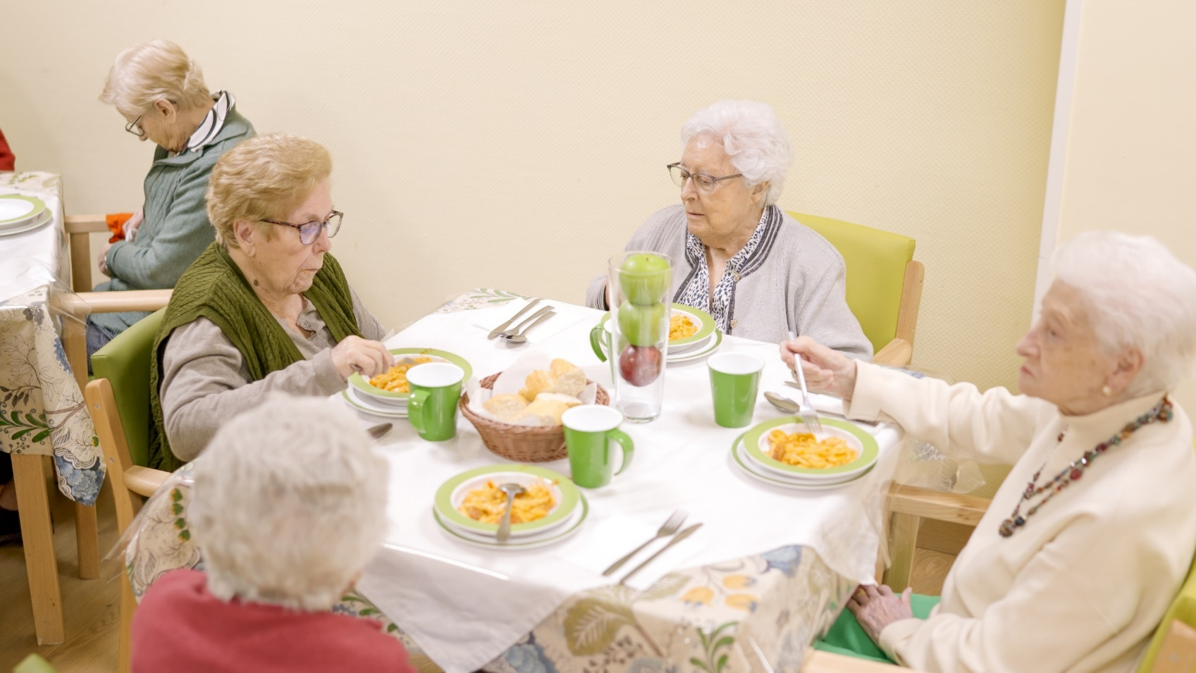

What is the clinical- and cost-effectiveness of oral nutritional supplements and fortified food on quality of life and nutritional outcomes compared to routine practice in older care home residents?
Study aim?
REFRESH is a study to test how best to treat undernutrition in older adults living in care homes

Slide 3








Better management of malnutrition can….
Mental and physical health deterioration
Care burden
Independence
GP visits
Appetite
Hospital visits
Overall improved quality of life!

Slide 4

Why participate?
Collaborate to improve nutrition management for residents
Nutrition training & support for staff in participating care homes
Free resources & reimbursement for participation

Slide 5

We aim to….
  Recruit 90 care homes in three cohorts:
COHORT 1
COHORT 2
COHORT 3
30 CARE HOMES
10 South West
10 West Midlands
10 Dorset/Hampshire/Bath/Bristol
Set-up starts: April 2025
Recruitment to start: November 2025
30 CARE HOMES
10 South West
10 West Midlands
10 Dorset/Hampshire/Bath/Bristol
Set-up starts: April 2026
Recruitment to start: August 2026
30 CARE HOMES
10 South West
10 West Midlands
10 Dorset/Hampshire/Bath/Bristol
Set-up starts: October 2026
Recruitment to start: April 2027

Slide 6
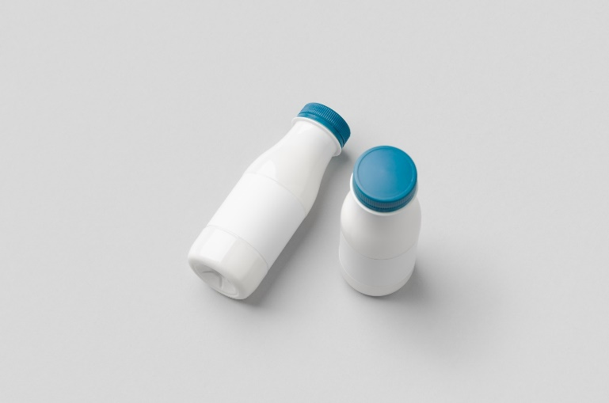

How will it work?
Care homes randomly assigned into ONE of THREE groups
Testing TWO approaches of managing malnutrition
ONS Group: residents provided with oral nutrition supplements (ONS)
Usual care group: carry on with usual routines for management of malnutrition
FF Group: residents provided with fortified food (FF) and drinks

Slide 7

Information to be collected
QUALITY OF LIFE
nutritional status
weight
food intake
activities of daily living
use of antibiotics
use of health and social care services
costs effectiveness
mortality
Sub-study: understand barriers to recruitment and retention of older residents from different ethnic backgrounds.

Slide 8
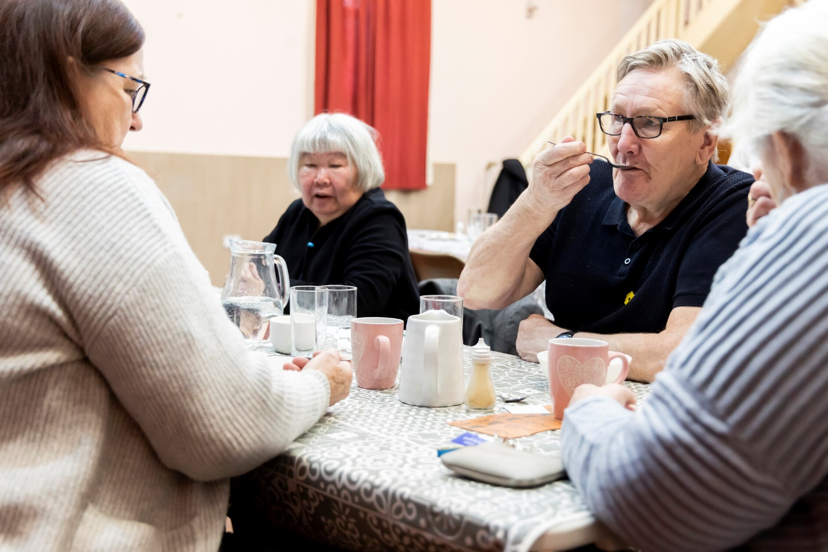
Who can join the study?
Care homes eligible to take part
Long-term residential care setting where older adults receive 24-hour care and support.
Have care homeowner permission to take part.
Not taking part in other research studies that could affect study
Residents eligible to take part
Over 65 years (permanent residents)
Able to eat and drink
Risk of undernutrition or undernourished
will include those living with dementia
Ineligible if
on ONS or fortified meals
on cancer treatment
recent surgery
end of life

Slide 9


Payments
Costs associated with food fortification reimbursed
ONS supplied by study
Cost of time staff spent on project reimbursed

Slide 10









What is the clinical- and cost-effectiveness of oral nutritional supplements and fortified food on quality of life and nutritional outcomes compared to routine practice in older care home residents?
Study aim?
REFRESH is a study to test how best to treat undernutrition in older adults living in care homes
HTA: NIHR160348

Slide 11
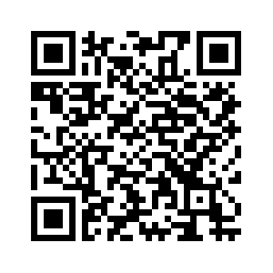






For more information or how to get involved?
Scan QR code to find out more!
Visit our website
https://www.plymouth.ac.uk/refresh-trial
Contact: Dr Esther Muriuki refresh.penctu@plymouth.ac.uk
esther.muriuki@plymouth.ac.uk
Images via Apetito and Adobe creative cloud

