Slide 1
International Recruitment Update
March 2026

Slide 2
International Recruitment update
Restrictions on Care Worker and Senior Care Worker recruitment
Upcoming changes to Indefinite Leave to Remain (ILR) rules/ Earned Settlement.

Slide 3
Background: Salary and Skill Level Increase July 2025
As of 22 July 2025:
The general salary threshold for skilled workers went up from £38,700 to £41,700. Certificates of sponsorships issued after 22 July will have to comply with the new rates (exemptions do exist including for care workers and senior care workers);
The minimum skill level is increasing from RQF Level 3 (A Level equivalent) to RQF Level 6 (Graduate Level);
Transition arrangements for skill level increase are in place to exempt Level 3-5 occupations on Immigration Salary List (including Care Workers and Senior Care Workers) and Temporary Shortage List;
Varying rules on salaries depending on when the sponsored worker was first issued with a Certificate of Sponsorship;
From 16 December 2025: Immigration Skills charge increased: Small/Charitable Sponsors rose from £364 to £480 per year, while Medium or Large Sponsors increased from £1,000 to £1,320 per year.

Slide 4
Winding down recruitment of Care Workers and Senior Care Workers
Relevant for SOC codes 6135 and 6136
ending of sponsorship from overseas as of July 2025;
care providers can still sponsor workers from inside the UK until 22 July 2028;
ability to switch employees from other routes or extend existing visas is dependent on three months service;
still possible to employ care workers from other providers as long as they are already on 6135 or 6136 SOC codes;
No longer a need to consult with pool of displaced workers.

Slide 5
Indefinite Leave to Remain Reforms
Existing standard qualifying period is five years of continuous lawful residence (not all routes qualify but sponsored employment does);
The announced intention is to increase to ten-year period with increase and decreases applying depending on circumstances
There will also be additional conditions that must be met such as no criminal convictions and a requirement to speak English to A Level standard.
Consultation closed on 12 February 2026 – results expected imminently.
Changes take effect April 2026.

Slide 6
Changes announced to Indefinite Leave to Remain (ILR)
From April 2026:
those on social care visas will now have 15-year qualification period to apply for ILR;
applicants to ILR will also need to demonstrate:
        a clean criminal record;
        the need to speak English to A-Level standard;
        the need to demonstrate sustained National Insurance contributions;
        the need to be debt free (no current litigation, NHS, tax or other government debt).
consultation was intended to consider the rights of children and victims of certain crimes and whether state benefits should only be available to those with British Citizenship and not those with ordinary ILR.
Announcement in late 2025 was rules will apply to everyone currently in the UK. If unchanged, that for all those currently on a route to settlement, these changes will effectively be retroactive, however…
The recent consultation sought views on whether some transitional arrangements should be put in place, which may offer some hope that the five-year qualification period might remain in place temporarily for certain people.

Slide 7
Questions and Potential Consequences for all of the above
Government have announced existing ILR will not be curtailed – no one will have their existing ILR status removed.
How retroactive will the qualification changes be? Will there be any transition period?
Will the 15 year period be able to be reduced? Consultation considering integration and contribution methods
If no transition period, will we see an exodus of sponsored workers?
If employers decide they do not or cannot sponsor someone for 15 years rather than 5, will
they be able to terminate sponsored employment? Risks of unfair dismissal and indirect
race discrimination
Advice: apply for ILR before April 2026 if eligible

Slide 8
Questions

Slide 9
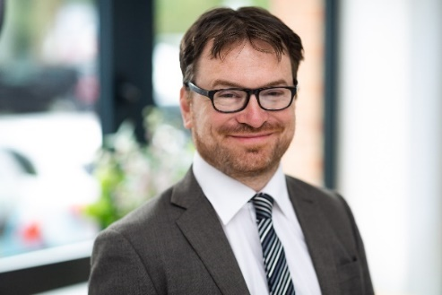
Thank you
Adrian Henderson
Associate
T: 07917 904776
adrian.henderson@rwkgoodman.com

