Slide 1

Digital Skills in
Adult Social Care
Rob Smith
Digital Skills Lead
Skills for Care

Slide 2

Introduction
Skills for Care is working under the NHS Transformation Directorate to deliver a digital skills programme for adult social care up until the end of March.
The programme has included the development of digital skills and best practice self-assessments, and the delivery of a series of digital events and webinars for adult social care providers, training providers and awarding organisations.

Slide 3




Digital Skills
‘What Good Looks Like’
Self-Assessment
(for care organisations)
Digital Skills
Self-Assessment
(for people working in care)
Digital Skills
e-Learning
Events and Support

Slide 4
‘What Good Looks Like’ Self-Assessment
Skills for Care is working in partnership with Partners for Care and Health, and the Digital Care Hub, to deliver the content for a self-assessment tool for a digital ‘What Good Looks Like (WGLL) Framework’ for adult social care organisations.
The self-assessment will help adult social care providers on their digital journey. It will help them to benchmark and baseline themselves around digital capabilities and improvement; understand their achievements and their gaps of digital focus; develop their digital vision; and to make the case for change.
This self-assessment is planned to launch on the Digitising Social Care website at the end of March 2025.

Slide 5

‘What Good Looks Like’ Framework
The ’What Good Looks Like’ Framework for adult social care supports both care providers and local councils with the digital capabilities, competencies and training required in adult social care.
It provides a series of common goals for all organisations to work towards that will help achieve the vision set out in People at the Heart of Care. It is an aspirational framework designed to be used by both councils and care providers.
Well-Led
Ensure Smart Foundations
Safe Practice
Support Workforce
Empower People
Improve Care
Healthy Populations

Slide 6
‘What Good Looks Like’ Themes
Well-Led
Your organisation’s leaders fully understand the benefits of digital technology and have the confidence and capability to drive forward digital transformation, sharing and learning from best practice.
Ensure Smart Foundations
Your organisation has modern and secure digital infrastructure, and staff have reliable access to comprehensive and up-to-date digital records.
Safe Practice
Good data and cyber security means organisations can safely use and share information which can improve care and support for people.
Support Workforce
Supporting your workforce means developing a skilled, capable workforce who can confidently identify, recommend and use appropriate technology safely and effectively for people drawing on social care.

Slide 7
‘What Good Looks Like’ Themes
Empower People
A person-centred approach to the design and use of digital technologies can improve people’s quality of life and wellbeing and support independence.
Improve Care
Effective use of digital technology, data and processes can support the delivery of outstanding quality and personalised care and support at the right place and at the right time.
Healthy Populations
Having good data to understand and plan for the needs of the population (whether at a community level or individual level) means that we can reduce inequalities and improve outcomes for all people.

Slide 8




‘What Good Looks Like’ Self-Assessment
Building a digital strategy
Digital maturity and transformation
Identify areas for development.
‘What Good Looks Like’
Results

Slide 9
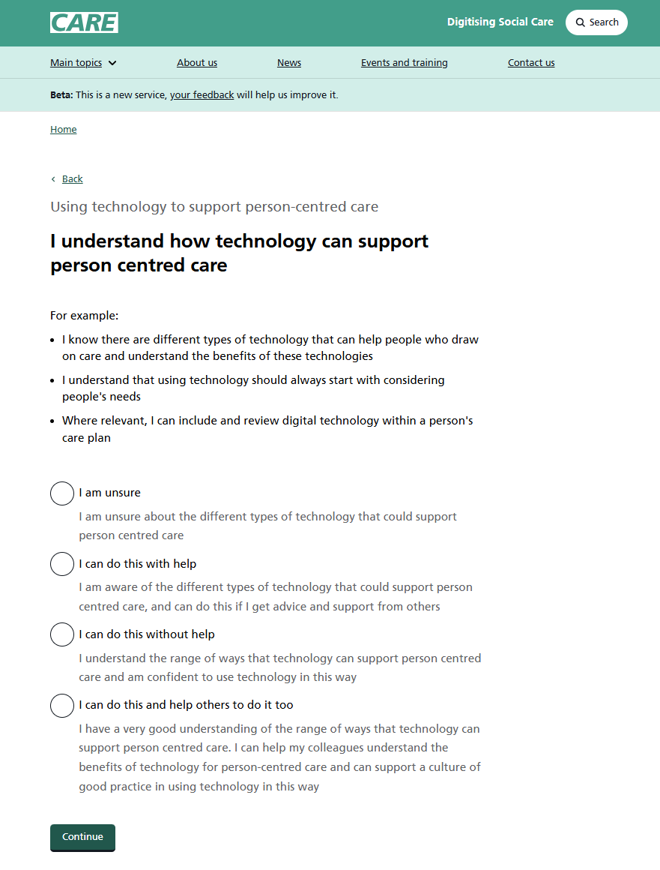
Digital Skills Self-Assessment
Skills for Care is working in partnership with Oxford Brookes to deliver the content for an online self-assessment tool for the Digital Skills Framework for adult social care.
The self-assessment will support people working in adult social care to identify areas of learning and personal skills development, and to be steered and signposted to information, training and resources to meet their needs.
This self-assessment is planned to launch on the Digitising Social Care website at the end of March 2025.

Slide 10
Digital Skills Framework
The Digital Skills Framework is a guide to digital skills, competencies and training required in adult social care. It can help support the development of digital skills across the adult social care workforce.
It defines seven key areas of effective digital working, organised in two ‘levels’: ‘skills for all’, and ‘go further’ with digital skills.
The framework can be used by social care employers to help with planning staff training or by individuals for their personal development.
Using Technology to Support Person-Centred Care
Technical Skills in Using Technology
Communicating through Technology
Using and Managing Data
Being Safe and Secure Online
Ethical Use of Technology
Digital Learning, Development and Wellbeing

Slide 11
Framework Themes
Using Technology to Support Person-Centred Care
This theme explores how technology is used to support person-centred care, and how people can make individual choices and decisions around using technology.
Technical Skills in Using Technology
This theme looks at different technologies involved in the day-to-day delivery of care, and some knowledge, support and signposting for how to access and use them.
Communicating through Technology
This theme explores technology in care that is used for communication, and how it can help people to connect with others to support their care and wider wellbeing.
Using and Managing Data
This theme explores the role, value and use of data within adult social care, how it plays a role in the delivery of care, and how it should be handled and used safely in line with people’s rights and choices.

Slide 12
Framework Themes
Using Technology to Support Person-Centred Care
This theme looks at how to stay safe and secure when using technology to connect and communicate online, and how to identify and navigate any risks, including what to do if there has been a breach of data security.
Being Safe and Secure Online
Ethical Use of Technology
This theme explores ethical principles and standards behind the use of technology in adult social care, so it is used safely, responsibly and to improve people’s care and quality of life.
Digital Learning, Development and Wellbeing
This theme looks at the role and value of using technology to support people’s continuous learning and development in care, and how to consider the health and wellbeing of yourself and others when using technology.

Slide 13
Digital Skills Self-Assessment
Improving the delivery of care
Personal development
Supporting workforce development
‘Skills for All’
Results
‘Go Further’

Slide 14

The Wider Journey
Digital Skills
Self-Assessment
(for people working in care)
‘What Good Looks Like’
Self-Assessment
(for care organisations)

Slide 15
Digital Skills e-Learning Modules
Skills for Care was commissioned by the NHS Transformation Directorate to create a suite of free-to-access ‘bitesize’ eLearning modules in line with the Digital Skills Framework.
The modules were co-developed with the adult social care sector, with contributions from care providers, local authorities, people drawing on care and support and subject matter experts.
The titles and themes of the seven modules are:
Using Technology to Support Person-Centred Care
Technical Skills in Using Technology
Communicating through Technology
Using and Managing Data
Being Safe and Secure Online
Ethical Use of Technology
Digital Learning, Development and Wellbeing

Slide 16
The Benefits
The digital skills modules offer people working in adult social care the opportunity for developing a broad base of digital knowledge and skills.
The modules include links and signposting to wider resources for further learning and development.
On the Skills for Care Virtual Learning Environment (VLE), the modules are accompanied by an electronic learner ‘notebook’ which can allow people to reflect on their own role and responsibilities, take notes and record any personal actions to take away.
Learners will be able to download certificates for the modules, which can help support their learning pathway towards digital qualifications.
The modules have been co-developed with staff and people accessing care to be practical and useful and focus on priority areas and topics around using technology in the delivery of care.

Slide 17
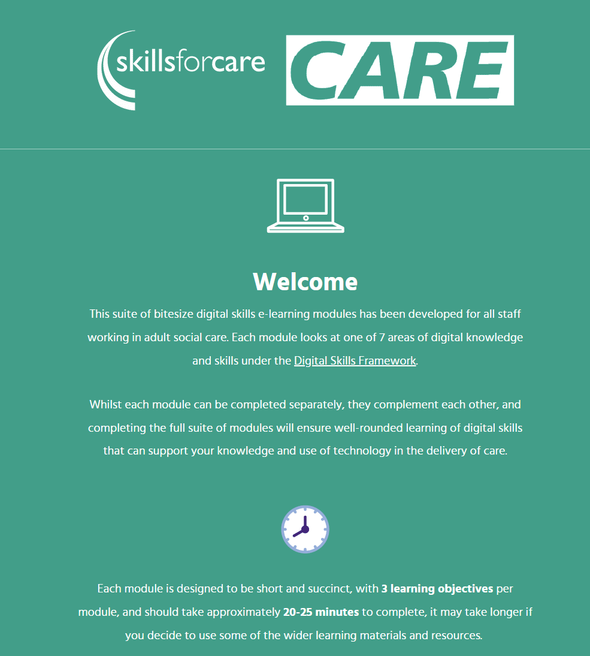
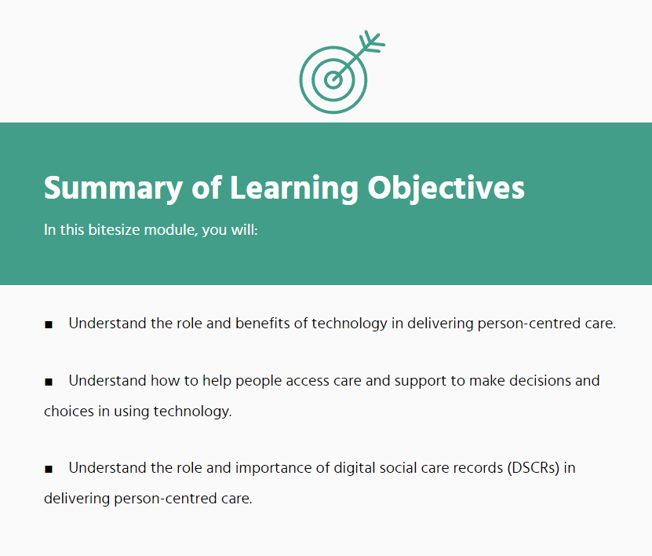
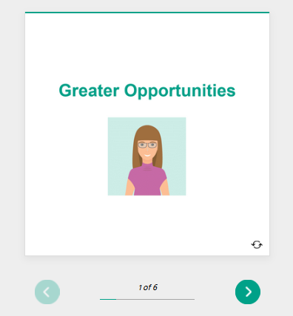
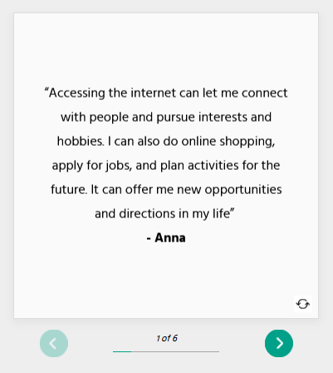
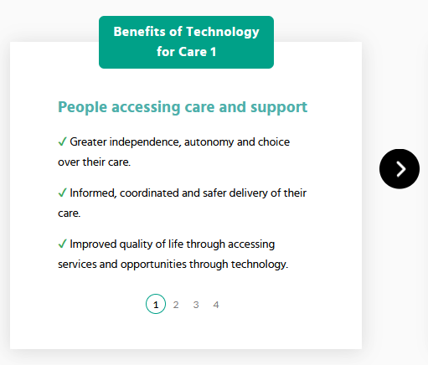
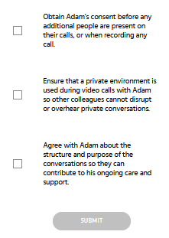
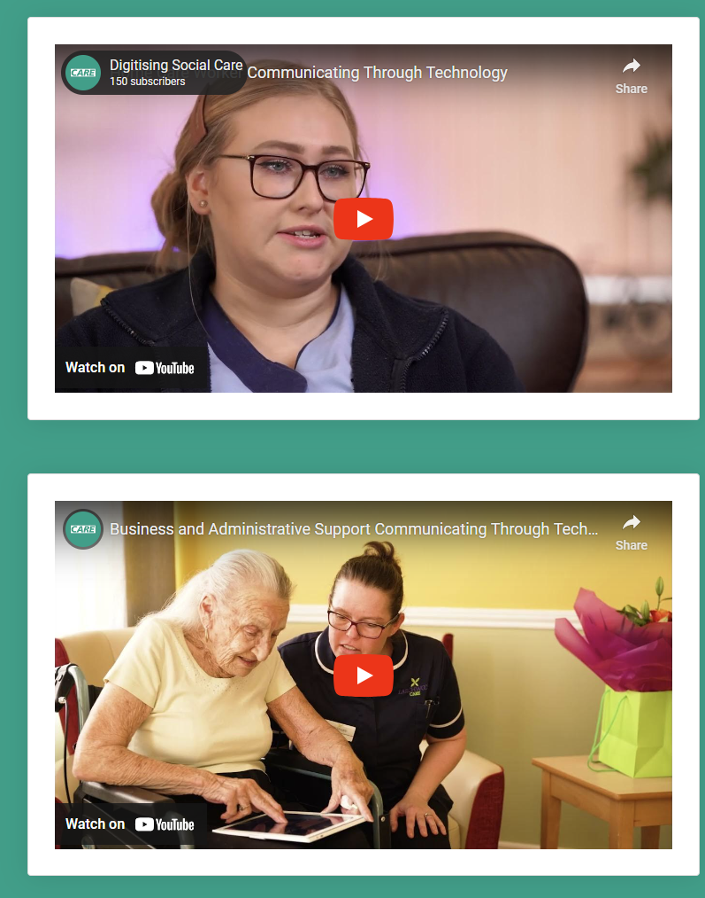
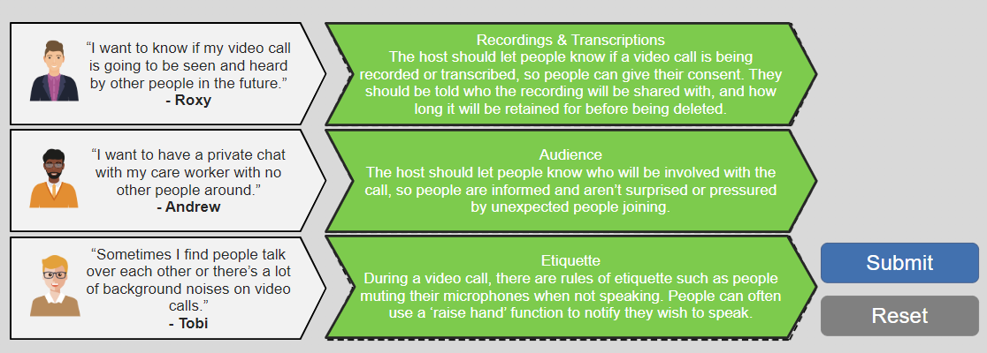
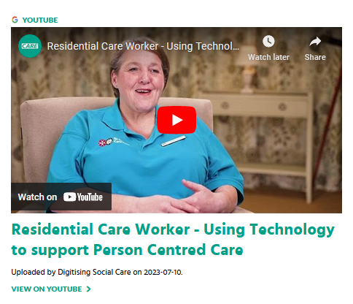
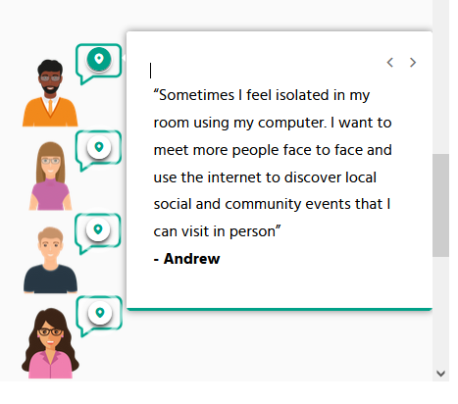
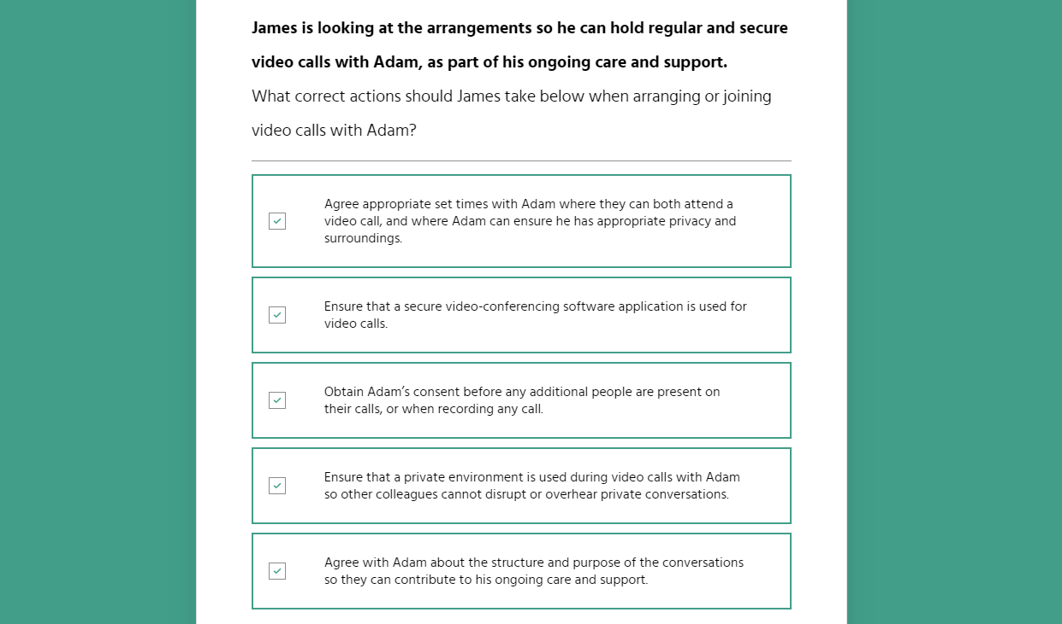
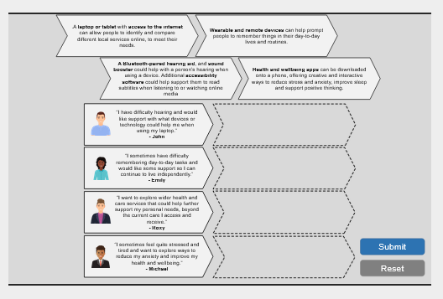
Module Activities
Each module contains a mix of learning activities, including:
Flip-cards
Scrolling Segments
Quiz
Sometimes you will need to flip cards to see more details on a subject or person’s perspective. Press the cards to flip them and click the left/right arrow buttons to see all the cards.
Some segments have mini-pages where you can use the arrow buttons to navigate left and right to see all the pages.
A few modules have quizzes with questions where you can select a choice of answers and then submit to see if you are correct.
Card Matching
Videos
Hotspots
For some activities you will have to press and drag cards to boxes, to match two things together to get the right answer.
Every module has embedded videos. We encourage you to watch these videos that provide broader perspectives on the use of technology in care.
Some modules contain hotspots and speech bubbles which you can press to see more information in a text box.

Slide 18
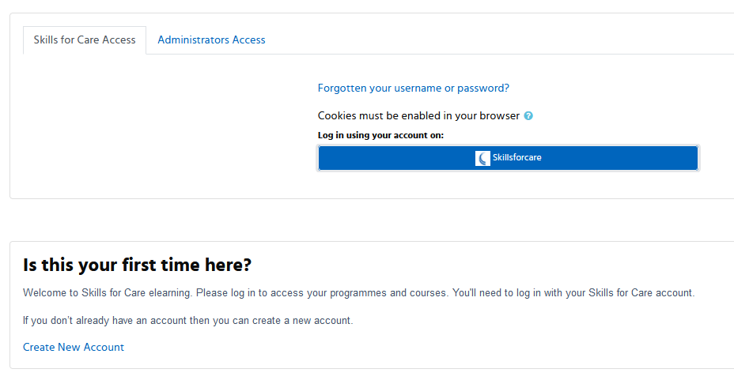
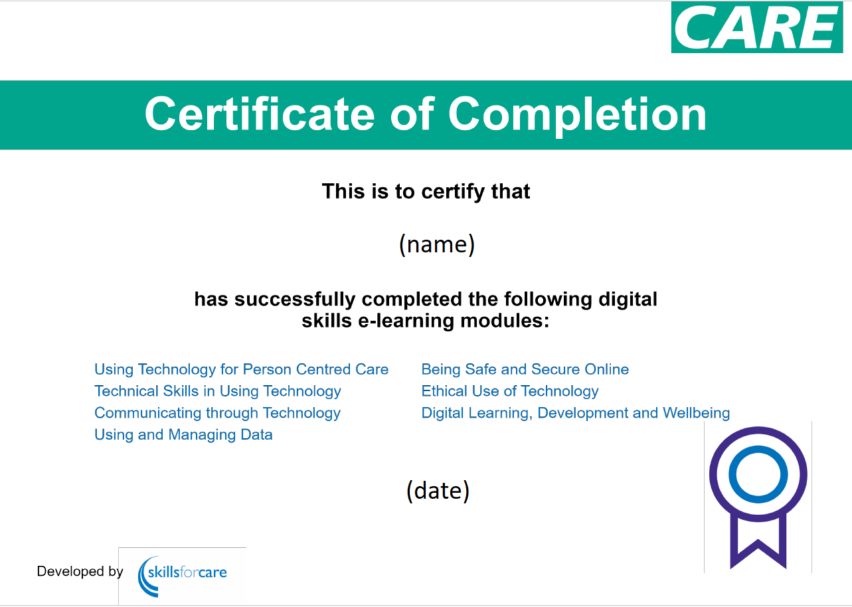
Accessing the Modules
The modules can be accessed for free on the Skills for Care VLE.
You can learn more about how to enrol and access the modules on our Skills for Care web page here:
https://www.skillsforcare.org.uk/digitalskillselearning
Each learner can receive an individual certificate upon completing each module, and a full ‘suite’ certificate once all seven modules are completed.

Slide 19



Digital, Data & Technology Webinars
Webinar Recordings
These webinars have provided registered managers with support and practical information that can help get them started on their digital journey. Our aim is to help everyone embrace technology and plan their digital journey, one step at a time.
Exploring the benefits of technology in adult social care
I wish I knew then what I know now - sharing lessons and learnings from early adopters of digital approaches
Change management - sharing lessons and learnings from managers leading digital change in their services
“I’m a technophobe, get me out of here!” – taking the fear out of digital for social care managers
You can access the recorded webinars on our website here

Slide 20
Registered Managers Webinar
We are holding a webinar for registered managers on the 25th March exploring digital skills, learning and digital self-assessments.
This will include a demonstration of our upcoming digital self-assessments being launched at the end of March.

Slide 21
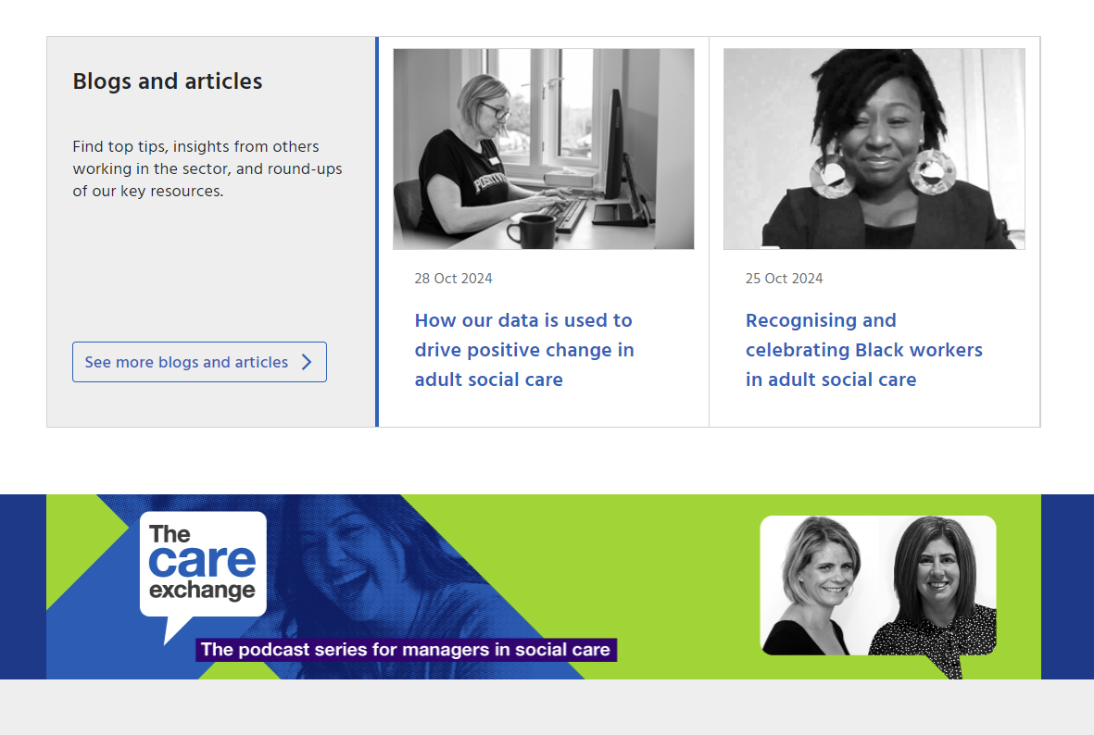
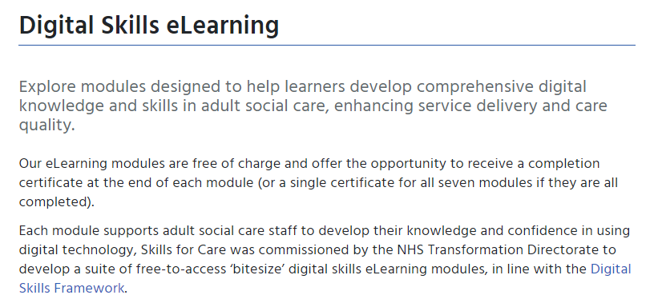
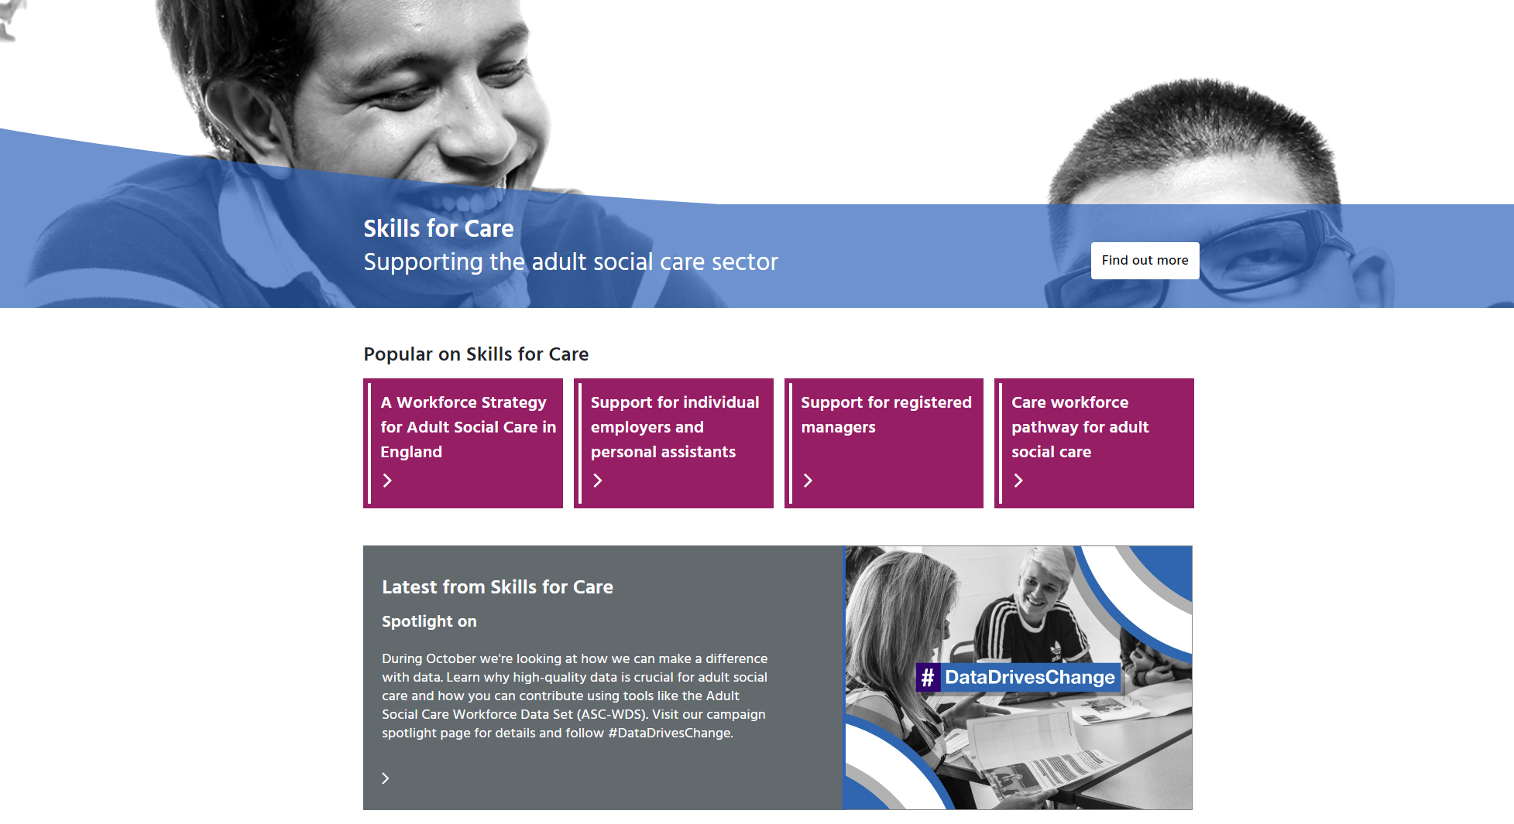
Contact Us
If you would like to get in touch about our digital skills work, you can contact our digital skills team at digital@skillsforcare.org.uk.
You can visit our website at www.skillsforcare.org.uk.

Slide 22
Thank You

