Slide 1
Oliver McGowan Training, funding, Resources and Updates
Jill.Croskell@skillsforcare.org.uk
12th March 2026
Notes:
Quick Intro:
Covering Context
Code of Practice
Legal Obligations
CQC Implications
Training and funding for Training
I have also included a quick look at the Care Workforce Pathway

Slide 2
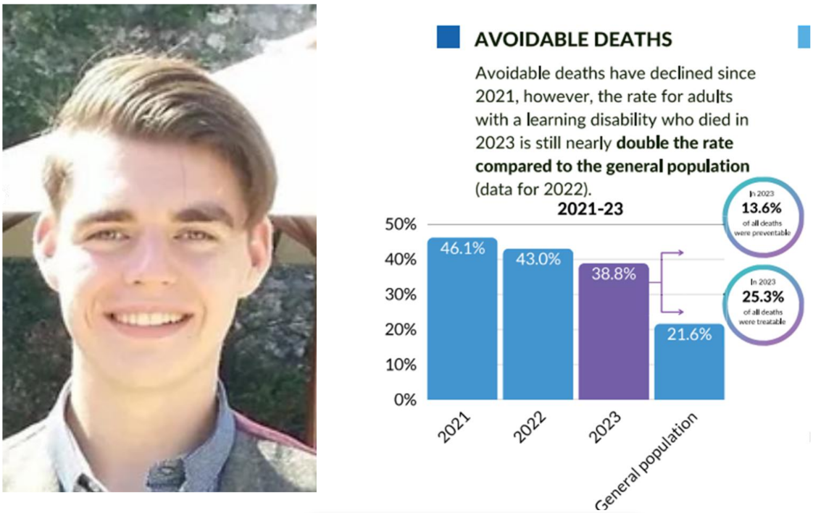
Why mandatory training?
Notes:
Just a bit of context here, why the learning is so important..
The training is named after Oliver McGowan who was a young autistic teenager with a mild learning disability, who died in 2016 after having a severe reaction to medication which he and his family had asked for him not to receive. Oliver’s parents, Paula McGowan and Tom McGowan, have since campaigned for better training for staff.

Slide 3
Background
The health and care act 2022 introduced a requirement for all H&SC providers registered with CQC to ensure staff receive training on LD and autism appropriate to their role.
The Oliver McGowan code of practice was finalised in 2025. It guides providers on how to meet the above and CQC will take it into account as part of their regulatory activity.
Oliver McGowan mandatory training is the government’s preferred package
Notes:
The Mandate and what it means for you..

Slide 4
The Code of Practice
Provides information on responsibility to ensure that staff undertake training on learning disability and autism every 3 years, or more regularly if required
Providers are responsible and best placed to identify training most appropriate to the roles, responsibilities and learning needs of their staff
Details the tiers and gives examples of roles mapped to these for illustrative purposes
Notes:
What is the Code of Practice-
Over 3 million people have completed the elearning package which is the first part of Oliver’s Training and over 2700 trainers are trained to deliver the interactive second part of this training across the country.
The first part of both Tiers is this eLearning module
The Oliver McGowan Mandatory Training on Learning Disability and Autism - elearning for healthcare

Slide 5
How will the CQC use the Code of Practice?
The CQC regulate health and social care providers registered with CQC on the statutory requirement on learning disability and autism training, in line with the requirements of Regulation 18 of the Health and Social Care Act 2008 (Regulated Activities) Regulations 2014.
More information is available here: Training staff to support autistic people and people with a learning disability - Care Quality Commission (cqc.org.uk).
Specific queries about CQC’s regulatory approach can be sent to enquiries@cqc.org.uk including ‘Mandatory training requirement on learning disability and autism / Code of Practice’ in the subject line.
Notes:
https://www.cqc.org.uk/guidance-providers/training-staff-support-autistic-people-and-people-learning-disability
Relates to regulation 18
Requirement for staff to be competent and trained isn’t new, reference to learning disabilities and autism is
Won’t tell you how to meet legal requirements, but you should consider all guidance and circumstances to decide the most appropriate training
CQC will use the code to decide whether a service meets the regulation
Where staff have been trained, they will look at how you ensure competency and application to practice
Where staff are yet to be trained, they will look at what action you’ve taken to mitigate risk and how you plan to address this.

Slide 6
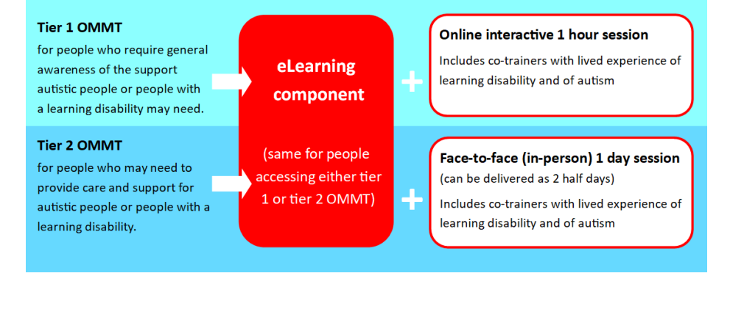
Different tiers of training
Notes:
The Oliver McGowan Mandatory Training comes in two parts. The first part is an eLearning module, and the second part is either an online interactive session (Tier 1) or a face-to-face session (Tier 2). All of the training includes delivery by people with lived experience of a learning disability or of being autistic.
Both parts of the Oliver McGowan Mandatory Training have been added to Skills for Care’s Adult Social Care Workforce Data Set (ASC-WDS) so that employers can record and report on completion rates.

Slide 7
Oliver McGowan Mandatory Training (‘Oliver’s Training’)
Funding arrangements and reimbursement rates
Funding to support Oliver’s Training is available to the adult social care sector through the Learning and Development Support Scheme (LDSS), separate to the overall existing LDSS funding already available for other training courses and qualifications. The LDSS is administered by NHSBSA via the online claims service.
You will need an up-to-date ASC-WDS account to claim funding.
Updated FAQs available (2 December 2025) here.
Recording of the ‘Overview on the mandatory training requirement on learning disability and autism: What you need to know about the code of practice’ 13 November webinar
Procured training - reimbursement rates
Tier 1 - £25.00 | Tier 2 - £90.00
In-house training - reimbursement rates
Tier 1 - £12.50 | Tier 2 - £50.00
Notes:
DHSC is providing funding to support rollout of the Oliver’s Training to the adult social care sector as part of the Learning and Development Support Scheme (LDSS). This funding will be specific to Oliver’s Training, separate to the overall existing LDSS funding already available for other training and qualifications. Training completed between April 2025 and March 2026 will be eligible for reimbursement. Providers will need an up-to-date ASC-WDS account to claim funding.
Procured training (when an ASC provider registered with the CQC pays an external company to deliver Oliver’s Training with costs charged per staff member completing the course).
Tier 1 – £25
Tier 2 - £90
In-house training (when a trainer is employed by an ASC provider registered with the CQC to internally deliver a session of Oliver’s Training to its staff).
Tier 1 - £12.50
Tier 2 - £50
UPDATED FAQS available (2 DECEMBER 2025): https://www.skillsforcare.org.uk/Developing-your-workforce/Care-topics/Oliver-McGowan-Mandatory-Training/Oliver-McGowan-Mandatory-Training.aspx
ASC-WDS: http://www.skillsforcare.org.uk/ascwds
LDSS guidance document: https://www.gov.uk/government/publications/adult-social-care-learning-and-development-support-scheme

Slide 8
Links to the Quality Assured Care Learning Service (QACLS)
This service from the Department of Health and Social Care (DHSC) and delivered by Skills for Care reviews the quality of individual courses and qualifications delivered by training providers to ensure that training and development is of good quality, easily accessible, meets the needs of the workforce and users of care services.
As part of this service, Skills for Care quality assures training providers who deliver Oliver's Training to the ASC sector against a Quality Framework which was coproduced with autistic people and people with a learning disability.
The purpose of quality assuring Oliver’s Training is to ensure that there is a list of quality assured training providers who can demonstrate they can deliver Oliver’s Training to the ASC workforce against the quality framework. This support's employers to make informed decisions when commissioning Oliver’s Training, improving the quality of training offered and access to and uptake of training within the ASC sector.

Slide 9
Funding
£11.98M available to claim for reimbursement of Oliver’s training in 25/6 from a separate Learning and Development Support Scheme (L&DSS), claimed pot via the NHS BSA portal. This is limited and will be allocated on a first come, first serve basis.
For external training you can claim £25 for tier 1 and £90 for tier 2. For in-house training you can claim £12.50 for tier 1 and £50 for tier 2.
To claim, you need to:
Be registered with CQC
Ensure you have a Skills for Care ASC-WDS account
Complete a L&DSS onboarding form
Submit once training is paid for and completed, providing evidence
External training must be provided by those on NHSE’s list of providers delivering Oliver’s training
Notes:
Claiming for the funding
Separate LDSS pot for Oliver’s training.

Slide 10
Adult Social Care Learning and Development Support Scheme (LDSS)
CALL FOR ACTION: Claim funding for training for you and your workforce
The LDSS scheme supports adult social care employers to invest in learning and development for their staff, by providing a financial contribution towards the costs of training. Up-to-date information, including guidance for employers and a list of courses and qualifications eligible for funding can be found on the Government website. (Updated to include Oliver’s Training information).
The LDSS is administered by NHSBSA via the online claims service.
FAQs available.
Adult Social Care Workforce Data Set (ASC-WDS) | Up-to-date account required to claim funding
Did you know that to claim LDSS funding, you need an up-to-date ASC-WDS account?
Find out more about ASC-WDS |
Notes:
Over 3,500 care employers have signed up to claim from the LDSS, accessing government funding to support their staff to undertake training courses and qualifications. For example, since the scheme launched in September 2024, nearly 5,000 claims for the L2ASCC qualification have been accepted.
Don’t miss out on your chance to claim as well. This financial year, the LDSS is backed by up to £12 million.
August 2025: FAQs available on Skills for Care’s website, co-produced with DHSC and NHSBSA
https://www.gov.uk/government/collections/adult-social-care-learning-and-development-support-scheme
https://www.skillsforcare.org.uk/Funding/Learning-and-development-funding-for-adult-social-care.aspx#Webinar
Staff recruited overseas are eligible for the LDSS funding, as long as they are legally employed in England and have a NI number.
BACKGROUND (UPDATED ON 27 OCT WITH REVISED WORDING FROM DHSC FOR 2024/25.
The LDSS is open to new claims for eligible training courses and qualifications that have been paid for in financial year 2025 to 2026. It is also open to completion (‘40’) part claims for qualifications that complete in financial year 2025 to 2026, where the qualification was started within the financial year 2024 to 2025.
Note that a 3-month claims window applies:
for training courses - claims must be submitted within 3 months of course completion.
for qualifications - an initial ‘qualification start’ claim must be submitted within 3 months of the qualification being paid for and started (whichever is the later date) and the ‘qualification completion’ claim must be submitted within 3 months of qualification completion.
LDSS will accept applications for courses and qualifications that are delivered internally.
A step-by-step guide on how to claim funding is available on the Skills for Care website. https://www.skillsforcare.org.uk/Funding/Learning-and-development-funding-for-adult-social-care.aspx
(UPDATED 13 Oct – ASC-WDS INFO INCLUDED ON THIS SLIDE AND NOTES HERE)
The Adult Social Care Workforce Data Set (ASC-WDS) is a data collection service, commissioned and funded by the Department of Health and Social Care. It is the leading source of intelligence for the adult social care workforce.​
​
You can gain access to funding for training your staff the Learning and Development Support Scheme (LDSS). You need an ASC-WDS account to be eligible to claim funding. These funds have saved care providers thousands of pounds. ​
The system provides safe and free storage of staff records and can help you to manage your training records - get expiry alerts when training is due to expire, define mandatory training for different job roles.

Slide 11
Resources
SfC’s dedicated webpage includes:
FAQs (updated after the webinar)
Diagrams
Videos
Links to the CoP, e-learning and CQC and NHSE webpages
Subscribe to enews to stay up-to-date.
Notes:
Please see our dedicated OM webpage for further updates and resources..

Slide 12
Overview of the mandatory training requirement on learning disability and autism: what you need to know about the code of practice
SfC webinar 13.11.25 with DHSC, NHS BSA, CQC and NHSE
Watch it here: Oliver McGowan Mandatory Training on Learning Disability and Autism and the Oliver McGowan Code of Practice
Notes:
UPDATE (8 December) – Updated FAQs
‘Overview on the mandatory training requirement on learning disability and autism: What you need to know about the code of practice’ webinar took place on 13 November 2025. We shared an overview of the Oliver McGowan Code of Practice, which set out how Care Quality Commission (CQC) registered providers can meet the statutory training on learning disability and autism appropriate to their staffs’ roles. We were joined by the Department of Health and Social Care (DHSC), NHS Business Services Authority (NHSBSA), CQC and NHS England on this webinar. There was a Q&A with our speakers, where we used frequently asked questions from registration to help shape the discussion.
https://www.skillsforcare.org.uk/Developing-your-workforce/Care-topics/Oliver-McGowan-Mandatory-Training/Oliver-McGowan-Mandatory-Training.aspx#Recordedwebinar
On this web page, you’ll find links to resources, FAQs, guidance documents and other information that was referenced during the webinar.
NEW SLIDE (27 Oct)
Oliver’s Training (UPDATED 27 OCT with reimbursement rates shared below)
The Department of Health and Social Care has now published the Oliver McGowan Code of Practice. The purpose of the code is to explain what is meant by training that is ‘appropriate to the person’s role’ and to provide guidance on how to ensure all staff receive such training.
https://www.gov.uk/government/publications/oliver-mcgowan-code-of-practice/the-oliver-mcgowan-draft-code-of-practice-on-statutory-learning-disability-and-autism-training
DHSC is providing funding to support rollout of the Oliver’s Training to the adult social care sector as part of the Learning and Development Support Scheme (LDSS). This funding will be specific to Oliver’s Training, separate to the overall existing LDSS funding already available for other training and qualifications. Training completed between April 2025 and March 2026 will be eligible for reimbursement. Providers will need an up-to-date ASC-WDS account to claim funding.
Procured training (when an ASC provider registered with the CQC pays an external company to deliver Oliver’s Training with costs charged per staff member completing the course).
Tier 1 – £25
Tier 2 - £90
In-house training (when a trainer is employed by an ASC provider registered with the CQC to internally deliver a session of Oliver’s Training to its staff).
Tier 1 - £12.50
Tier 2 - £50
UPDATED FAQS available (2 DECEMBER 2025): https://www.skillsforcare.org.uk/Developing-your-workforce/Care-topics/Oliver-McGowan-Mandatory-Training/Oliver-McGowan-Mandatory-Training.aspx
ASC-WDS: http://www.skillsforcare.org.uk/ascwds

Slide 13
Adult Social Care Reforms
Care Workforce Pathway
National ASC Workforce Pathway
Funding LDSS
Level 2 Certificate
Casey Review
Notes:
Here are some of the key Care Reforms - Care Workforce Pathway and the National Social Care Workforce Pathway ,Level 2 Certificate and the Casey Review.

Slide 14
Level 2 Adult Social Care Certificate (L2ASCC) qualification
An accredited qualification designed to provide a baseline standard to care, reduce the need for repeat training and give recognition to our care workforce. Ofqual-regulated, requiring workplace assessment, completed in 6–8 months (or less), claim £1,540 LDSS funding.
Find out more: www.skillsforcare.org.uk/CareCertificateQual
Updated August 2025: Factsheets and FAQs for care providers, care workers and training provides
Updated Care Certificate Standards
The Care Certificate Standards have been updated to align with sector developments and the introduction of the L2ASCC qualification.
The standards deﬁne the knowledge, skills and behaviours expected of speciﬁc job roles in health and social care. They can be used to inform what information is covered during induction.
A self-assessment tool and an assessor and employer guide are available to support the standards. There is also a summary of the updates and a set of FAQs.
See the updated standards
Notes:
AMENDED: 15 Sept
UPDATE TO NOTES (29 SEP)
DID YOU KNOW THAT SINCE THE LDSS LAUNCHED IN SEPTEMBER 2024, NEARLY 5,000 CLAIMS FOR THE L2ASCC QUALIFICATION HAVE BEEN ACCEPTED?
UPDATE IN AUGUST 2025: Revised factsheets and FAQs for care providers, care workers and training providers - www.skillsforcare.org.uk/CareCertificateQual
(Main updates: Reference to £1,540 LDSS funding maximum reimbursement (previously £1,500) and references the Foundation Apprenticeship and how this links to L2 learning).
https://www.skillsforcare.org.uk/CareCertificateQual
https://www.gov.uk/government/publications/adult-social-care-learning-and-development-support-scheme/learning-and-development-support-scheme-for-the-adult-social-care-workforce-a-guide-for-employers
https://www.skillsforcare.org.uk/Developing-your-workforce/Care-Certificate/Care-Certificate-standards.aspx
Why choose the L2ASCC?
Eligible employers can claim LDSS funding for up to £1,540 per qualification. (Ensure your ASC-WDS account is up-to-date to meet eligibility requirements)
Designed to ensure staff have the most up to date knowledge and baseline skills.
Help staff feel valued and recognised as part of professional workforce.
Currently 54% of direct care workers do not have a level 2 or above qualification. The introduction of the Level 2 Adult Social Care Certificate qualification will provide people in care roles the most up-to-date knowledge and baseline skills required to support people well and succeed in their roles.
For those who have been in the sector for several years and deserve acknowledgement for the skilled care they provide, the qualification will also provide a route for them to gain a recognised qualification. Investing in training and support for staff will act as an incentive for staff recruitment, retention and development within the workforce.
It’s based on the 15 standards from the original Care Certificate to reflect best practice but with a greater depth of learning and portability.
Aimed at new starters and those without existing qualifications. It’s expected to take a new learner around 6-8 months to complete.
This could be reduced for more experienced learners through any reliable and sufficient recognition of prior learning. Care Certificate standards and induction training may be counted as prior learning. The training provider should clearly set out how prior learning can be used in the assessment process before enrolment.

Slide 15
The Care Workforce Pathway
Notes:
A brief update

Slide 16
Defining the Pathway
A flexible, universal career structure for Adult Social Care
Clearly defined role categories
Role specific knowledge, skills and behaviours
Universal role values
Example role personas
Role specific learning opportunities
Focused tools and resources
The Pathway is a career structure which applies to practical care settings and includes roles employed in Adult Social Care or those directly provided by Local Authorities.
It covers those who deliver, coordinate, and manage care, and also recognises the vital support of ancillary staff who help make care possible.
The Pathway is not ‘mandatory’, but it’s strategically important, because transforming adult social care starts with investing in the people who deliver it.

Slide 17







What the Pathway aims to do
The Pathway is a universal career structure for the adult social care sector, which aims to:
Professionalise non-regulated adult social care roles
Improve recruitment and retention of the adult social care workforce
Enhance the quality and standards of care provided through a skilled, confident and competent workforce
Promote adult social care as a viable and rewarding long-term career option
Sets clear expectations for training, development and competence
Supports workforce planning for now, and the future

Slide 18

Role categories
Published Roles
New to Care | Care / Support Worker | Personal Assistant | Enhanced Care Worker | Supervisor / Leader | Practice Leader | Deputy Manager | Registered Manager
Roles currently in development
Nominated Individual | Care/Digital Technologist | Activities Co-Ordinator
Quality Assurance | Learning and Development | Corporate middle / senior managers
Corporate admin roles | Ancillary roles
Notes:
This gives you an idea of the published roles and those in development currently.
There will be a move shortly to social care Nurses, Occupational Therapists and Social Workers to create a seamless pipeline.

Slide 19
Currently published role categories
New to Care | Care/Support Worker | Personal Assistant | Enhanced Care Worker | Supervisor/ Leader | Practice Leader | Deputy Manager | Registered Manager
Entry point for individuals with no prior experience in social care. | Provides direct care and support to individuals | Provides support and is directly employed by the person being supported or their representative. | Delivers more complex care, including delegated healthcare tasks. | Leads a team and supports care delivery. | Leads on specialist practice and supports others to improve. | Supports the Registered Manager in running the service. | Leads the service and ensures regulatory and legal compliance.
Key duties: Focused on learning and induction Shadowing and basic support tasks No independent responsibilities Ideal for probation or onboarding phase | Key duties: Personal care (washing, dressing, toileting) Assistance with eating and mobility Supporting access to activities and community Promoting independence and wellbeing May require clinical oversight depending on duties | Key duties: One-to-one, person-directed support across daily living, social, employment and health-related tasks Flexible, personalised care based on individual preferences and routines No formal leadership responsibilities; Works independently under the direction of the person drawing on care | Key duties: Condition-specific or specialist support Delegated healthcare tasks from professionals (e.g. Nurses, OTs) Requires additional, auditable training Requires ongoing competency assessments No leadership responsibilities | Key duties: Supervises care staff Supports staff development May manage rotas or shift planning Acts as a point of escalation Explores career progression into practice or management | Key duties: Develops and maintains a specialism Coaches and mentors others Leads on best practice in a specific area Stays up to date with sector developments Drives quality improvement in practice | Key duties: People management and staff development Supports decision-making and service delivery Acts as manager in the registered managers absence Helps ensure regulatory compliance May be preparing for a registered manager role | Key duties: Strategic and operational leadership Ensures safe, person-centred care Staff training, recognition, and support Regulatory compliance and inspections Makes informed decisions about service delivery
Notes:
These are the published role categories, giving guidance for role and responsibilities.

Slide 20
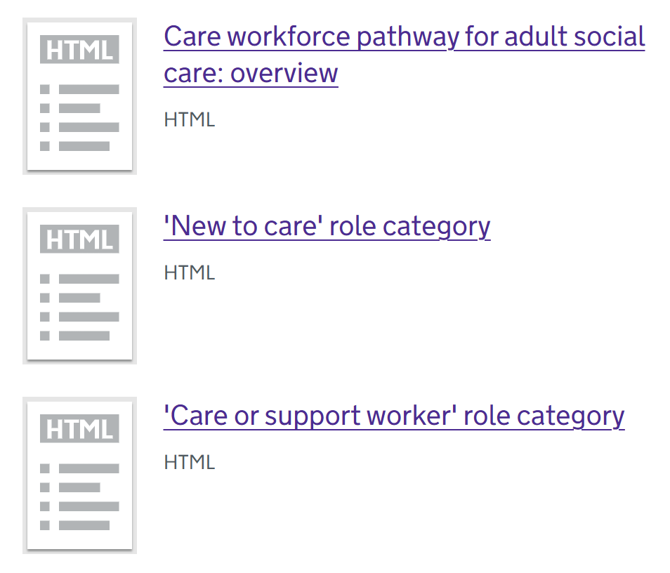
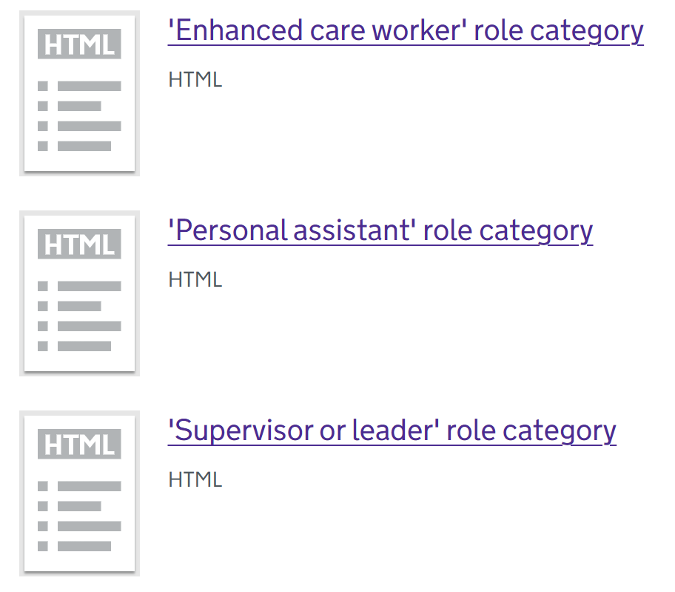
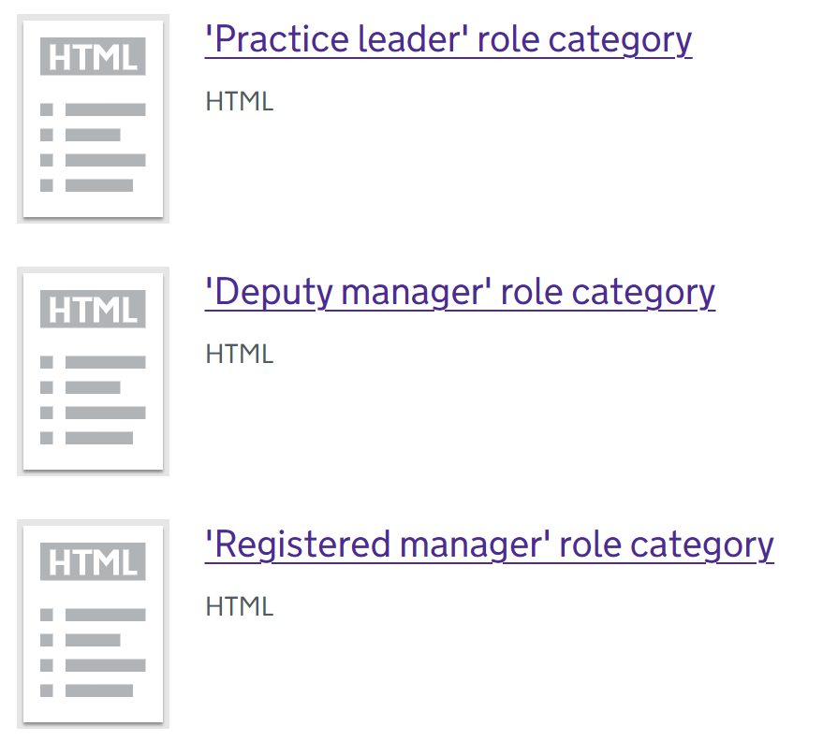
Finding the role categories
www.gov.uk/government/publications/care-workforce-pathway-for-adult-social-care
Notes:
Here are the links to find the full details of the role categories.
We don’t have the time to go into these today.

Slide 21

Explore the Pathway
What | Why | How
Get to know the Pathway to understand how it can support your organisation. | The Pathway can seem big at first and using it could lead to changes in your organisation. That’s why it’s important to start by thinking about what you want to achieve and how the Pathway can help. Once you’re clear on your goals, you can take it step by step, making changes at a pace that works for you, and your team. | Check out each of the role categories in the Pathway. They can all be found on the GOV.UK website and each contain knowledge, skills, behaviours and values.
Learn from other organisations who have been using the Pathway already. | Learning from others who are already using the Pathway can help you to: Build confidence by showing that change is possible and has worked in similar settings. Save time and resources by adopting proven ways of working instead of starting from scratch. Spark ideas and innovation by exploring different approaches and perspectives. Strengthen buy-in from teams by sharing real-world success stories that feel relatable and achievable. | Visit the Skills for Care website to find case studies and a podcast.
Notes:
Here are a couple of slides to help with exploring the pathway by learning from other organisations and developing a broader understanding of the wider benefits of the pathway and links.

Slide 22

Explore the Pathway
What | Why | How
Check out the resources to support you to introduce the Pathway | There are a range of resources to support you to use the Pathway. You can find these on the Skills for Care website. These resources will be changing early next year, but looking at what’s available now, might inspire you to consider your approach to using the Pathway. | Visit the Skills for Care website to view resources.

Slide 23



Prepare to use the Pathway
What | Why | How
Get approval to introduce or test the Pathway in your organisation. | The Pathway may lead to changes that affect staff, budgets or other resources. Because of this, senior leaders will need to decide whether to use part or all of the Pathway. | You could write a report or briefing paper for your senior leaders, explaining what the Pathway is, its purpose, what it aims to achieve, and how it could support improvements in your organisation.
Set up a team to trial using part of it. | Introducing the Pathway will take planning, time, and motivation. There is no deadline to introduce or use the Pathway, you can do it at a pace that feels right for your people and your organisation, and you can align it to tasks that you already have planned (like reviewing job descriptions or your training programme). | Form a team to lead the work, this could include HR, Learning & Development (if you have them), and others who know your organisation well. Your team can help to: Develop a realistic plan Manage the process Align the Pathway with current policies Support staff communication and engagement
Agree your governance. | Using the Pathway may affect job descriptions, recruitment, and staff management, so you will need to ensure that any changes follow your organisation’s existing policies and governance arrangements. | Work with your leaders and your Pathway team to agree how decisions about using the Pathway will be made, including identifying any resources needed.
Notes:
Get help with, testing, team trials and governance..

Slide 24



Prepare to use the Pathway
What | Why | How
Consider what communication will be needed to keep your teams informed and involved throughout the process. | Because the Pathway is still new, staff within your organisation may be unfamiliar with it, and how it can support them, your organisation, those who support, and the wider sector. | You could: Share information about the Pathway Explain upcoming changes Invite feedback and questions Engage early with representative bodies
Explore funding opportunities to support your plans | Eligible adult social care employers in England can claim staff training costs from the LDSS and it is available for non-regulated care staff, including deputy and Care Quality Commission-registered managers and agency staff, within the adult social care workforce. | A full list of eligible training courses and qualifications can be found at Eligible training courses and qualifications - GOV.UK and further information can be found on the GOV.UK website. You can find a list of quality assured courses and qualifications on our website at Quality assured training and courses.
Join / use ASC-WDS | ASC-WDS can help you track and understand how the Pathway is making a difference in your organisation. The Adult Social Care Workforce Data Set (ASC-WDS) is a free online data collection service that covers the adult social care workforce in England. | You can find out more and view case studies from other employers which describe how ASC-WDS has helped them achieve a return on investment, on the Skills for Care website.
Notes:
Explore funding- LDSS, use ASC-WDS and effective communications.

Slide 25
Role categories and overview of the Pathway | GOV.UK Care workforce pathway for adult social care - GOV.UK
Supporting resources | Skills for Care The Care Workforce Pathway (please note all resources are currently under review and will be republished in 2026 based on sector insight and feedback).
Notes:
Here are the key links.

Slide 26
A national Strategy for the Adult Social Care Workforce
https://www.skillsforcare.org.uk/Workforce-Strategy/Home.aspx
Notes:
I wanted to include the national ASC workforce strategy as the underpinning framework for the social care reforms,
July 24
Social care is important for us all and the workforce is central to social care. This is a vital sector, adding £60 billion to the English economy each year. We are all living longer – which is, of course, a good news story – and the need for adult social care in England is estimated to significantly grow as a result.
In the 2022 report 'A Gloriously Ordinary Life'¹ published by the House of Lords Committee on Adult Social Care, the question of why we should care about adult social care is asked. "Our answer is blunt: it concerns all of us because at some point in our lives, we are all likely to support someone we care about, or to draw on care ourselves."
The number of people aged 65 and above is set to increase from 10.5 million to 13.8 million in England by 2035 - an increase of around 32%¹. The number of people with dementia is expected to rise by 43% by 2040 (from 982,000 today to 1.4 million). The number of people aged 18-64 with a learning disability, mental health need² or a physical disability is also projected to increase over this period. By the time a person is aged 75, they are 60% more likely to possess two or more significant conditions. This figure increases to 75% for those between the ages of 85 and 89 years old.³ A 2024 Healthwatch report highlights that social care support can be transformative for disabled people – but as many as 1.5 million working-age disabled people in England may not be getting the care they’re eligible for.⁴ We need a greater focus on living more healthy and happy years. We can do more now to prevent loneliness, isolation and escalating needs.
Our projections show that, if the number of adult social care posts grows proportionally to the projected number of people aged 65 and over in the population between 2023 and 2040, an increase of 29% (540,000 extra new posts) would be required by 2040.
But demographic changes are happening globally, not just in England. Some of our immediate neighbours are facing even more pronounced trends in their population having a proportionately older structure. At the same time, countries that we have typically recruited from, such as the Philippines, are seeing a change in the ratio of older people to working age people. We would expect to see those countries wanting to keep their own working age population and we might expect other countries to try to attract the working age population from the UK. We are going to have to recruit and retain more of our domestic workforce and make the roles more attractive so that they remain in the country.

Slide 27
Further support and resources
For registered managers and frontline managers
Notes:
I have curated what I think may be of use to you- for example CQC resources, medication tools and EDI Resources, Effective Supervision and Delegated Health Care Activities to name but a few, that you can use for selves and to support your staff and teams.
This will be sent out to you and if you have any queries, you have my email address.

Slide 28


Launching our brand-new dementia resources
Designed for anyone supporting people living with dementia including family carers, health and social care professionals and community workers
Our aim is to make dementia information more accessible, person-centred and practical.
We have developed resources to support the following areas:
Prevention
Before and after diagnosis
Support for people providing care and support
Family Carers
End of life
www.skillsforcare.org.uk/Dementia
Notes:
NEW: 8 DEC
https://www.skillsforcare.org.uk/Developing-your-workforce/Care-topics/Dementia/Dementia.aspx
Discover a range of resources, tools and videos to help support non-dementia specialist roles to provide effective and compassionate dementia care
Building connection and dementia communication videos
Top tips for a healthy lifestyle
Step-by-step guide to before and after diagnosis
Useful contact details
Distressed behaviours pocket guide
Benefits checklist
Carer’s rights factsheet
Emotional health workbook
End of life conversations guide
Understanding spirituality reflective booklet

Slide 29
Celebrating over 50,000 webinar views!
We’re excited to share that our registered manager webinars have been viewed over 50,000 times!
Explore over 35 recorded webinars covering a wide range of topics - they are delivered to a live audience and recorded for further viewing. The webinars are between 30-60 minutes long and are supported with resources and additional information.
Our new recorded webinars include:
Managing meds with confidence: Practical steps for safer care | Watch now
Managing risk: Good and best practice approaches for CQC regulated providers | Watch now
Getting stronger: How digital can work for you | Watch now
AI: Starting small, growing smarter | Watch now
Notes:
AMENDED: 17 Nov – 50,000 webinar views!
https://www.skillsforcare.org.uk/Rmwebinars
Managing meds: https://www.skillsforcare.org.uk/Support-for-leaders-and-managers/Support-for-registered-managers/Registered-manager-webinars/Care-topics.aspx#Managingmeds
Managing risk: https://www.skillsforcare.org.uk/Support-for-leaders-and-managers/Support-for-registered-managers/Registered-manager-webinars/Care-topics.aspx#ManagingriskGoodandbestpracticeapproachesforCQCregulatedproviders
Getting stronger: https://www.skillsforcare.org.uk/Support-for-leaders-and-managers/Support-for-registered-managers/Registered-manager-webinars/Digital-data-and-technology.aspx#Gettingstronger
AI: https://www.skillsforcare.org.uk/Support-for-leaders-and-managers/Support-for-registered-managers/Registered-manager-webinars/Digital-data-and-technology.aspx#AIStartingsmallgrowingsmarter

Slide 30
New resource | Standards for student supervision and assessment
Designed to prepare CQC registered managers to confidently take on the role of Practice Supervisor for nursing students
This new online resource will allow managers to develop their understanding and skills in supervising and supporting student nurses and nursing associates on placement in social care settings.
Standards for Student Supervision and Assessment - Registered Managers Resource
This resource, funded by the Department of Health and Social Care and developed by Skills for Care in partnership with the University of Exeter, provides clear guidance tailored specifically to social care settings.
Notes:
https://www.learningfor.care/store/4865940-standards-for-student-supervision-and-assessment-registered-managers-resource
This course is designed to prepare CQC-registered managers to confidently take on the role of Practice Supervisor for nursing students.
through four short modules, you’ll explore the context of student supervision in social care, understand the Nursing and Midwifery Council (NMC) standards, and build the skills needed to create safe, supportive, and inclusive learning environments.
You’ll gain clear guidance on your responsibilities, learn techniques for welcoming and orientating students, setting goals, giving feedback, and managing challenges. Case studies, videos, and downloadable tools bring the learning to life and help you apply it directly to your workplace.
By completing this programme, you will be suitably prepared to act as a Practice Supervisor in line with the NMC Standards for Student Supervision and Assessment (2018) — playing a vital role in shaping the nurses, and nursing associates of tomorrow and showcasing the value of the social care sector.

Slide 31

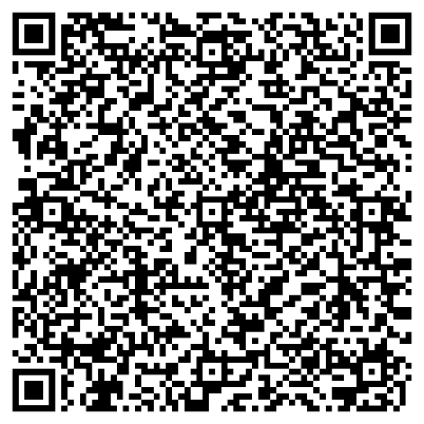
Delegated healthcare activities in action
Real-life case studies and local insights to support you in delegation.
These new resources capture real-life case studies and local insights to highlight how delegated healthcare activities can work differently across regions and settings
but with the same goal of improving outcomes for those who draw on care and support.
Explore the resources to learn and how you can apply these approaches in your own setting to deliver safe, effective, and person-centred care.
Notes:
https://www.skillsforcare.org.uk/Support-for-leaders-and-managers/Managing-a-service/Delegated-healthcare-activities/Delegated-healthcare-activities-in-action.aspx?utm_source=qrcode&utm_medium=slide_deck&utm_campaign=dha_in_action&utm_term=locality_teams
Explore our real-life case studies and local insights from our roadshow events to see how other across the regions are carrying out delegated healthcare activities. These resources highlight how delegated healthcare activities can work differently across regions and settings but with the same goal of improving outcomes for those who draw on care and support. Explore the resources to learn and how you can apply these approaches in your own setting to deliver safe, effective, and person-centred care.

Slide 32
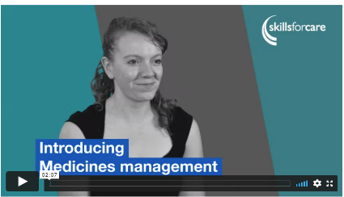
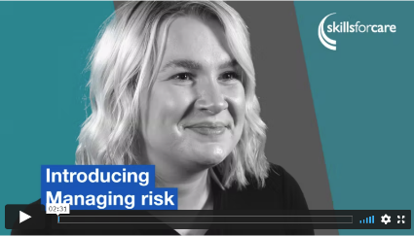
Support for the CQC Assessment Framework – Inspection toolkit
Recommendations, practical examples, advice and resources to support your CQC assessments
Ensure your service is prepared by exploring recommendations, practical examples and resources covering the 34 Quality Statements in our inspection toolkit.
Notes:
Inspection toolkit
https://www.skillsforcare.org.uk/Support-for-leaders-and-managers/Good-and-outstanding-care/Inspection-toolkit.aspx

Slide 33
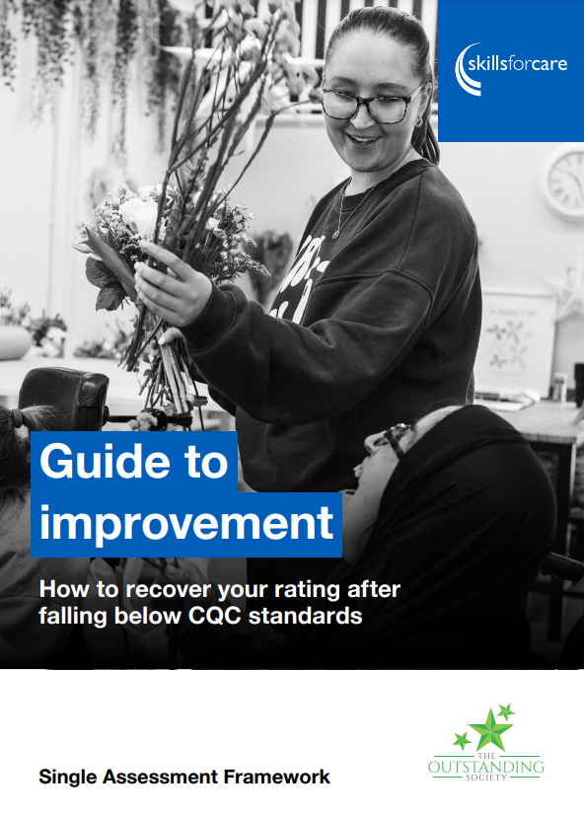
Guide to improvement
Skills for Care and The Outstanding Society have co-developed a new edition of our Guide to improvement
Shaped around the CQC Single Assessment Framework, the guide looks at what has caused adult social care services to be rated Requires improvement or Inadequate since 2023.
The guide is designed to help frontline managers and others at the service to embed sustainable solutions informed by services who have recovered their rating.
Discover how to engage your teams and identify practical solutions that will work for your service and understand the building blocks to improvement.
The guide is free and can be downloaded now
Notes:
https://www.skillsforcare.org.uk/resources/documents/Support-for-leaders-and-managers/good-and-outstanding-care/Improve-your-CQC-rating/Guide-to-improvement.pdf
Guide highlights
Understanding the building blocks to improvement, helping your service to overcome common barriers, embed a learning culture, and the system and processes needed to strengthen quality
How to engage your teams, service users, and stakeholders in identify practical solutions that will work for your service
What’s are the recurring issues causing services to fall below CQC expectations on each Quality Statement, how might this breach CQC regulations, and how to tackle these issues

Slide 34
Introductory modules for managers
11 eLearning modules to develop skills in leadership, succession planning and developing future talent
Leading and managing in adult social care
Supporting and developing teams
Regulation and governance
Effective communication
Working with partners
Leading a person-centred service
Safeguarding and mental capacity
Making decisions
Managing resources
Learning and innovating
Personal development and wellbeing
www.skillsforcare.org.uk/IntroductoryModulesForManagers
The cost per module is £40.
Discounts are available and the cost can be claimed back through LDSS.
10% discount for ASC-WDS account holders
Notes:
www.skillsforcare.org.uk/IntroductoryModulesForManagers
https://www.gov.uk/government/publications/adult-social-care-learning-and-development-support-scheme
Our new and improved Introductory modules for managers support the development of aspiring and new managers.
The modules offer engaging introductions to key topic areas to peak learners’ interest and provide opportunities to reflect, ideas to improve practices, and motivation to learn more. Based on the Manager Induction Standards, the re-developed modules now feature up to date content and increased accessibility for learners.
Module duration:
The modules will take between 40 to 60 minutes to complete and this can be done at a time and a pace to suit the learner. They’re simple and engaging to follow and are relevant across different services and settings.
Cost:
Price per single module: £40
Package deal price (full module suite): £350 (saving £90)
Each module (or the full bundle) is purchased on a 2-year renewable license, with enrolment access to the module for a period of 2 years from date of purchase.
You can access Skills for Care’s eLearning modules on our new learning management system, which provides an improved experience for customers accessing and completing our eLearning modules. www.learningfor.care
All the existing modules will be available to purchase on the new platform, except for the CQC modules which are currently being updated and will be available from the end of October.
Adult Social Care Workforce Data Set (ASC-WDS) account holders and bulk purchases will be eligible for a 10% discount. Payment is via debit or credit card. Bulk purchases will have the option to be paid via invoice.
More information about the modules can be found at www.skillsforcare.org.uk/eLearning

Slide 35

New: All Our Health eLearning
Discover this free eLearning module tailored for adult social care professionals, focusing on health promotion and preventive practices.
Tailored specifically for people who work in adult social care, this eLearning module has ten adult social care public health tips and an underlying theme of prevention.
Build on your existing knowledge to enhance support quality, with practical guidance on integrating public health approaches into daily care routines.
This free eLearning module is available now, developed by All Our Health.
Find out more
Notes:
https://www.skillsforcare.org.uk/Developing-your-workforce/Care-topics/Ten-public-health-tips-elearning-module/Ten-public-health-tips-elearning-module.aspx
It offers practical guidance on how your practice relates to public health approaches and how to further integrate these approaches into your day-to-day work, building on the knowledge you already have.
Great Induction Tool.
Key topics include preventing illness, promoting wellbeing and mental health, and supporting healthy aging. Completing the module will enhance the quality of care for those you support and deepen your understanding of public health.

Slide 36
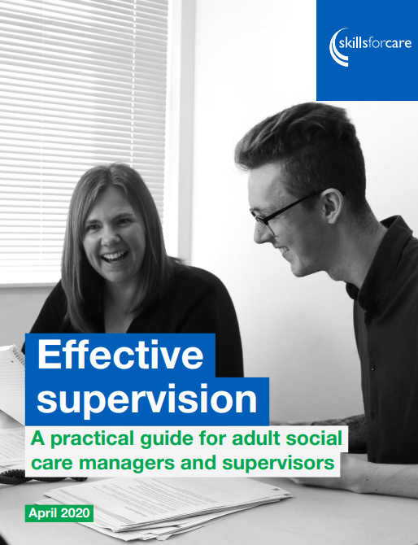
Effective supervision
Effective supervision supports good working relationships, helps you to address any issues and celebrate achievements.
Supervision plays a key role in supporting your workforce to deliver high-quality care and support.
Your workforce is your most valuable resource and Skills for Care has some resources to help you manage your workforce:
Effective supervision guide: this guide will help you to plan and deliver effective supervisions. It includes the supervision functions and why it’s important and attributes of a successful supervisor and how to develop supervisors
Effective supervision webinar: explore practical approaches to developing new supervision skills and how this benefits the staff you support
Find out more
Notes:
https://www.skillsforcare.org.uk/Support-for-leaders-and-managers/Managing-people/Supervision.aspx
Effective supervision guide: https://www.skillsforcare.org.uk/resources/documents/Support-for-leaders-and-managers/Managing-people/Supervision/Effective-supervision-guide.pd

Slide 37
National induction for health and social care
Skills for Care and NHS England have created free-to-access induction materials for anyone new to a role in health and social care
The ‘National induction for health and social care’ brings together virtual learning modules and resources to equip new starters with a clear understanding of health and social care, helping to build a sense of belonging and support retention.
It introduces different subjects important to social care, such as how to deliver personalised care, why we have regulation, what roles we might come across in our work and what they do.
All content is available online to use as part of your induction or as a refresher for existing staff, alongside your organisation specific induction.
Find out more
Notes:
https://learninghub.nhs.uk/catalogue/National-induction-for-health-and-social-care

Slide 38
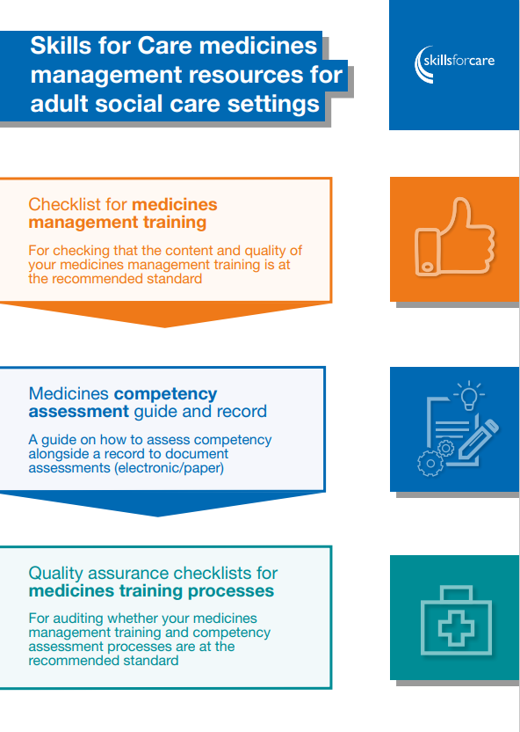
Medicines management resources
Resources and support for adult social care providers with medicines management
The resources have been developed for people who are responsible for purchasing and/or checking the quality of external or in-house medicines management training for care workers and managers.
Explore new medicines management guidance and checklists, developed to support care providers to assess their medicines management education and training to ensure that it is safe and effective.
You can also discover signposting and advice for meeting CQC expectations in this area.
Visit the webpage
Notes:
https://www.skillsforcare.org.uk/Support-for-leaders-and-managers/Managing-a-service/Prevention-in-social-care/Medicines-management-resources.aspx

Slide 39

Resources to support culturally appropriate care
These resources have been produced to help you have a clearer understanding of culturally appropriate care and what that may mean to individuals you support.
The ‘Culturally appropriate care guide’ covers a broad range of topics that will help you to learn about and be sensitive to people’s cultural identity or heritage.
Use the supporting training resources to implement the learning from the guide at your service.
www.skillsforcare.org.uk/CulturallyAppropriateCare
Notes:
www.skillsforcare.org.uk/CulturallyAppropriateCare
Notes:
The ‘Culturally appropriate care guide’ covers a broad range of topics that will help you to learn about and be sensitive to people’s cultural identity or heritage. Whether its looking to understand what is meant by exclusion and inclusion, find out how to focus on people’s life stories or improve support for people living with dementia, this guide is a great place to go for advice, insight and inspiration from real-life stories.
To support the learning within the guide, Skills for Care has also published a series of resources for use in training and development. These cover supporting individuals from ethnic minority groups and backgrounds, stereotyping, and supporting relationships and people who are lesbian, gay, bisexual, transgender, queer and others (LGBTQ+). They can be used individually, or as part of a whole package of training.

Slide 40

LGBTQ+ learning framework
This learning framework for working with LGBTQ+ people in later life aims to provide a base for identifying the insights, knowledge, understanding and skills that the social care workforce need to help them work effectively with individuals from gender and sexually diverse communities.
The framework is intended to be used by social care employers, employees, training providers, regulators, commissioners, policy makers and others to build their own knowledge and support colleagues’ understanding of how to better support LGBTQ+ people in later life.
Updated to include an additional topic which covers ‘LGBTQ+ religion and spirituality in later life’.
www.skillsforcare.org.uk/LGBTQFramework
Notes:
https://www.skillsforcare.org.uk/Support-for-leaders-and-managers/Supporting-a-diverse-workforce/LGBTQ-learning-framework.aspx

Slide 41

Training resources to help support personal relationships
Look at our training materials to help develop the skills and knowledge needed to support people who draw on services with personal relationships.
The trainer materials include PowerPoint slides, which are supported by a training facilitator guide, lesson plan and learner handouts and worksheets.
They complement our ‘Supporting personal relationships guide’ and are focused on enabling social care providers to offer support in a way that respects peoples’ choices and values whilst keeping them safe.
Find out more
Notes:
https://www.skillsforcare.org.uk/Developing-your-workforce/Care-topics/Supporting-personal-relationships/Supporting-personal-relationships.aspx
The programme includes a brief introduction, followed by four modules that can be delivered individually or as a complete package. The training areas are:
1. Understanding sexuality and relationships: barriers, benefits and the impact of staff values
2. Roles, regulations and the law
3. Sexual safety and autonomy
4. Practical approaches to relationships and sexuality support
The ‘Supporting personal relationships’ guide and trainer materials are supported by the Care Quality Commission and compliment their guidance around inspection in the area of relationships and sexuality in adult social care services.

Slide 42
Thank you and Goodbye!
Happy to be contacted.
Jill.Croskell@skillsforcare.org.uk

