Slide 1


Maximeyes Introduction –
Devon Care Home Collaborative

Slide 2
Agenda
Current wholesale market position
Future Predictions
Maximeyes Basket – How it works?
Energy Efficiency / On-site generation
Energy Management Tips
Q&A

Slide 3

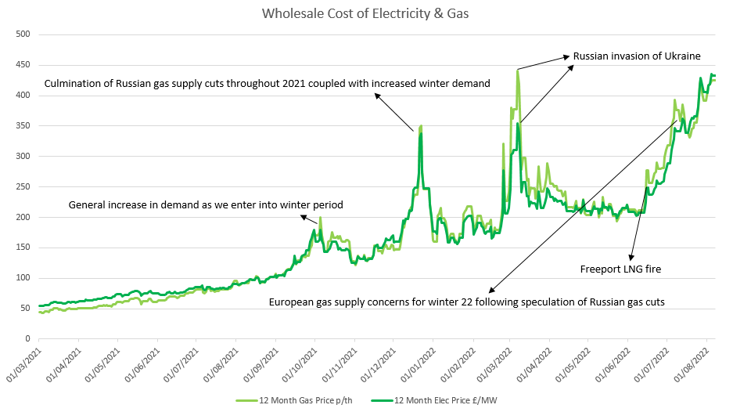
Wholesale Market graph
Although the wholesale market is unpredictable, many of the traders that we speak to believe, pending any further world events, that this level of wholesale costs could be seen for at least until summer 2023.

Slide 4
Historic Wholesale Market Movement

Slide 5
What can you do?
Competitive tender
Group bargaining
Time of buying

Slide 6
Maximeyes Basket
Started in 2005 – running successfully for 17 years
Group Bargaining - Care homes, Hotels, Dry Cleaners, Dental & Pharmacy Associations
Competitive tender – 15 suppliers
Time of buying – Track the market for min 9 months
e.g. 2020: 10 year low – action taken

Slide 7
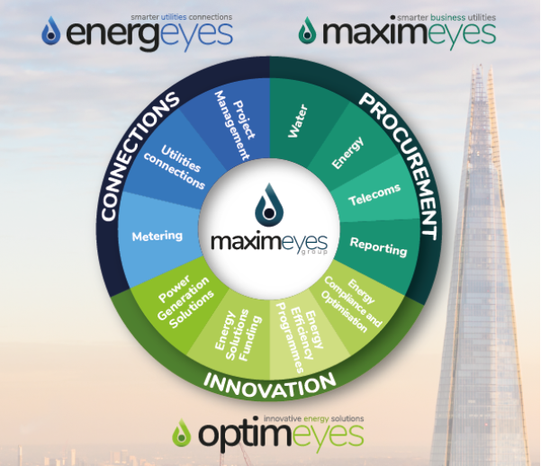
Wheel of services

Slide 8
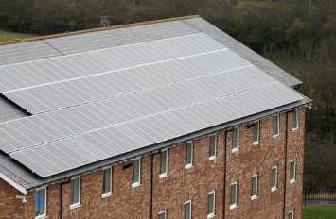
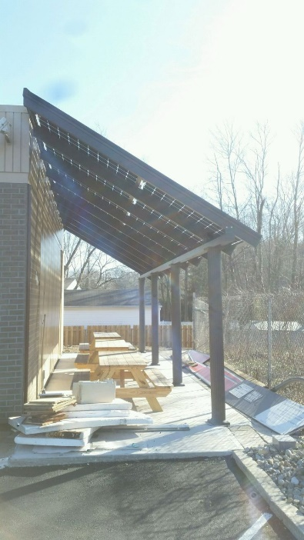

Solar Photovoltaic System
Consumption
PV Production
Benefits
Electric is the future, and your energy consumption will go up. Use the one source of energy which is in abundance- Solar!
Electricity tariffs may rise and fall but energy supplied from your own captive solar plant will be free- Lock in that rate now!
Payback period has reduced from 6 years to 2.5 years and with Super Deduction it is reduced further to 2 years
Life of a rooftop solar system is more than 25 years
Reduce your carbon footprint (Scope 2 emissions) and make your organisation's sustainable
Solar PV can be used to charge your battery storage and electric vehicles, reducing your need to purchase traditional grid-sourced electricity

Slide 9
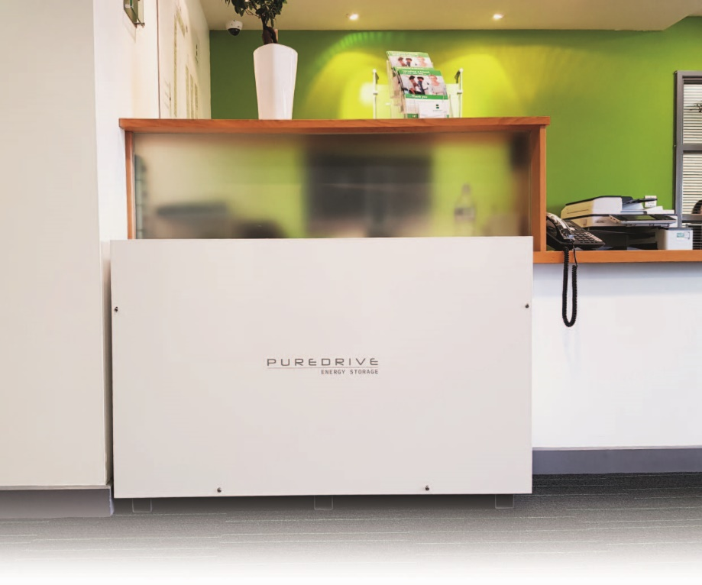
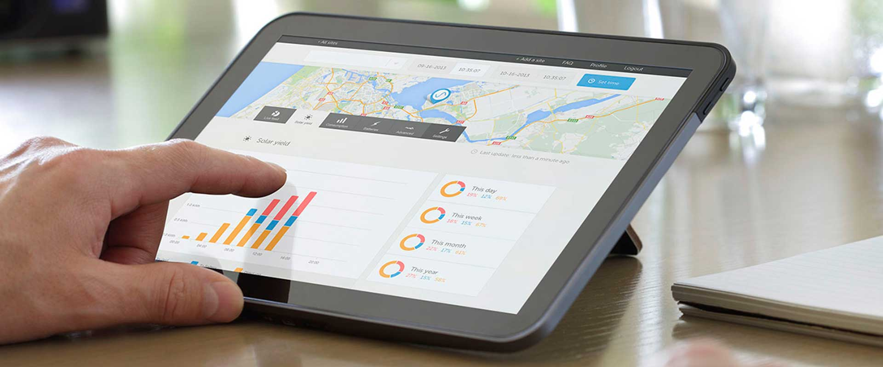
Battery Storage
Benefits
Backup solution in the event of power cuts, ensuring the safety of the residents
Storage for excess solar power generated during the day, increasing green energy usage and reducing electricity costs

Slide 10
Optimeyes - Portfolio of services

Slide 11
Energy Management Tips
Consumption Reporting (where possible)
Change standard bulbs to LED
Staff behaviour training (virtually or on site)
Regular meter readings
Replacing older equipment (where possible)

Slide 12
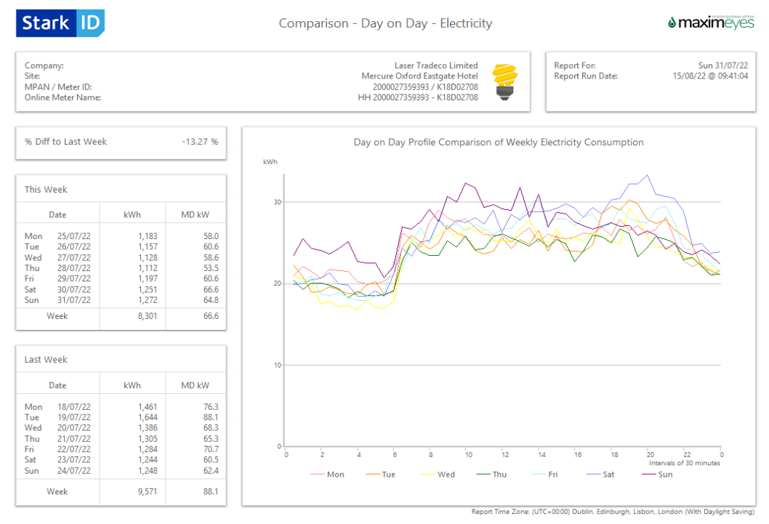
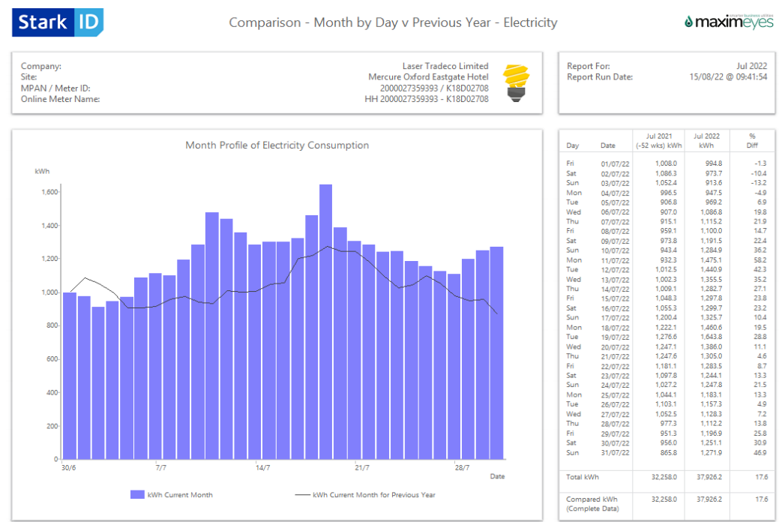
Consumption Report Examples

Slide 13
Q&A
Maximeyes UK Ltd
0208 652 7525
enquiries@maximeyes.me
Victoria Thomson

