Slide 1
SWASfT External Partner Presentation
Notes:
Who am I/Who are we?
Point of the presentation.

Slide 2
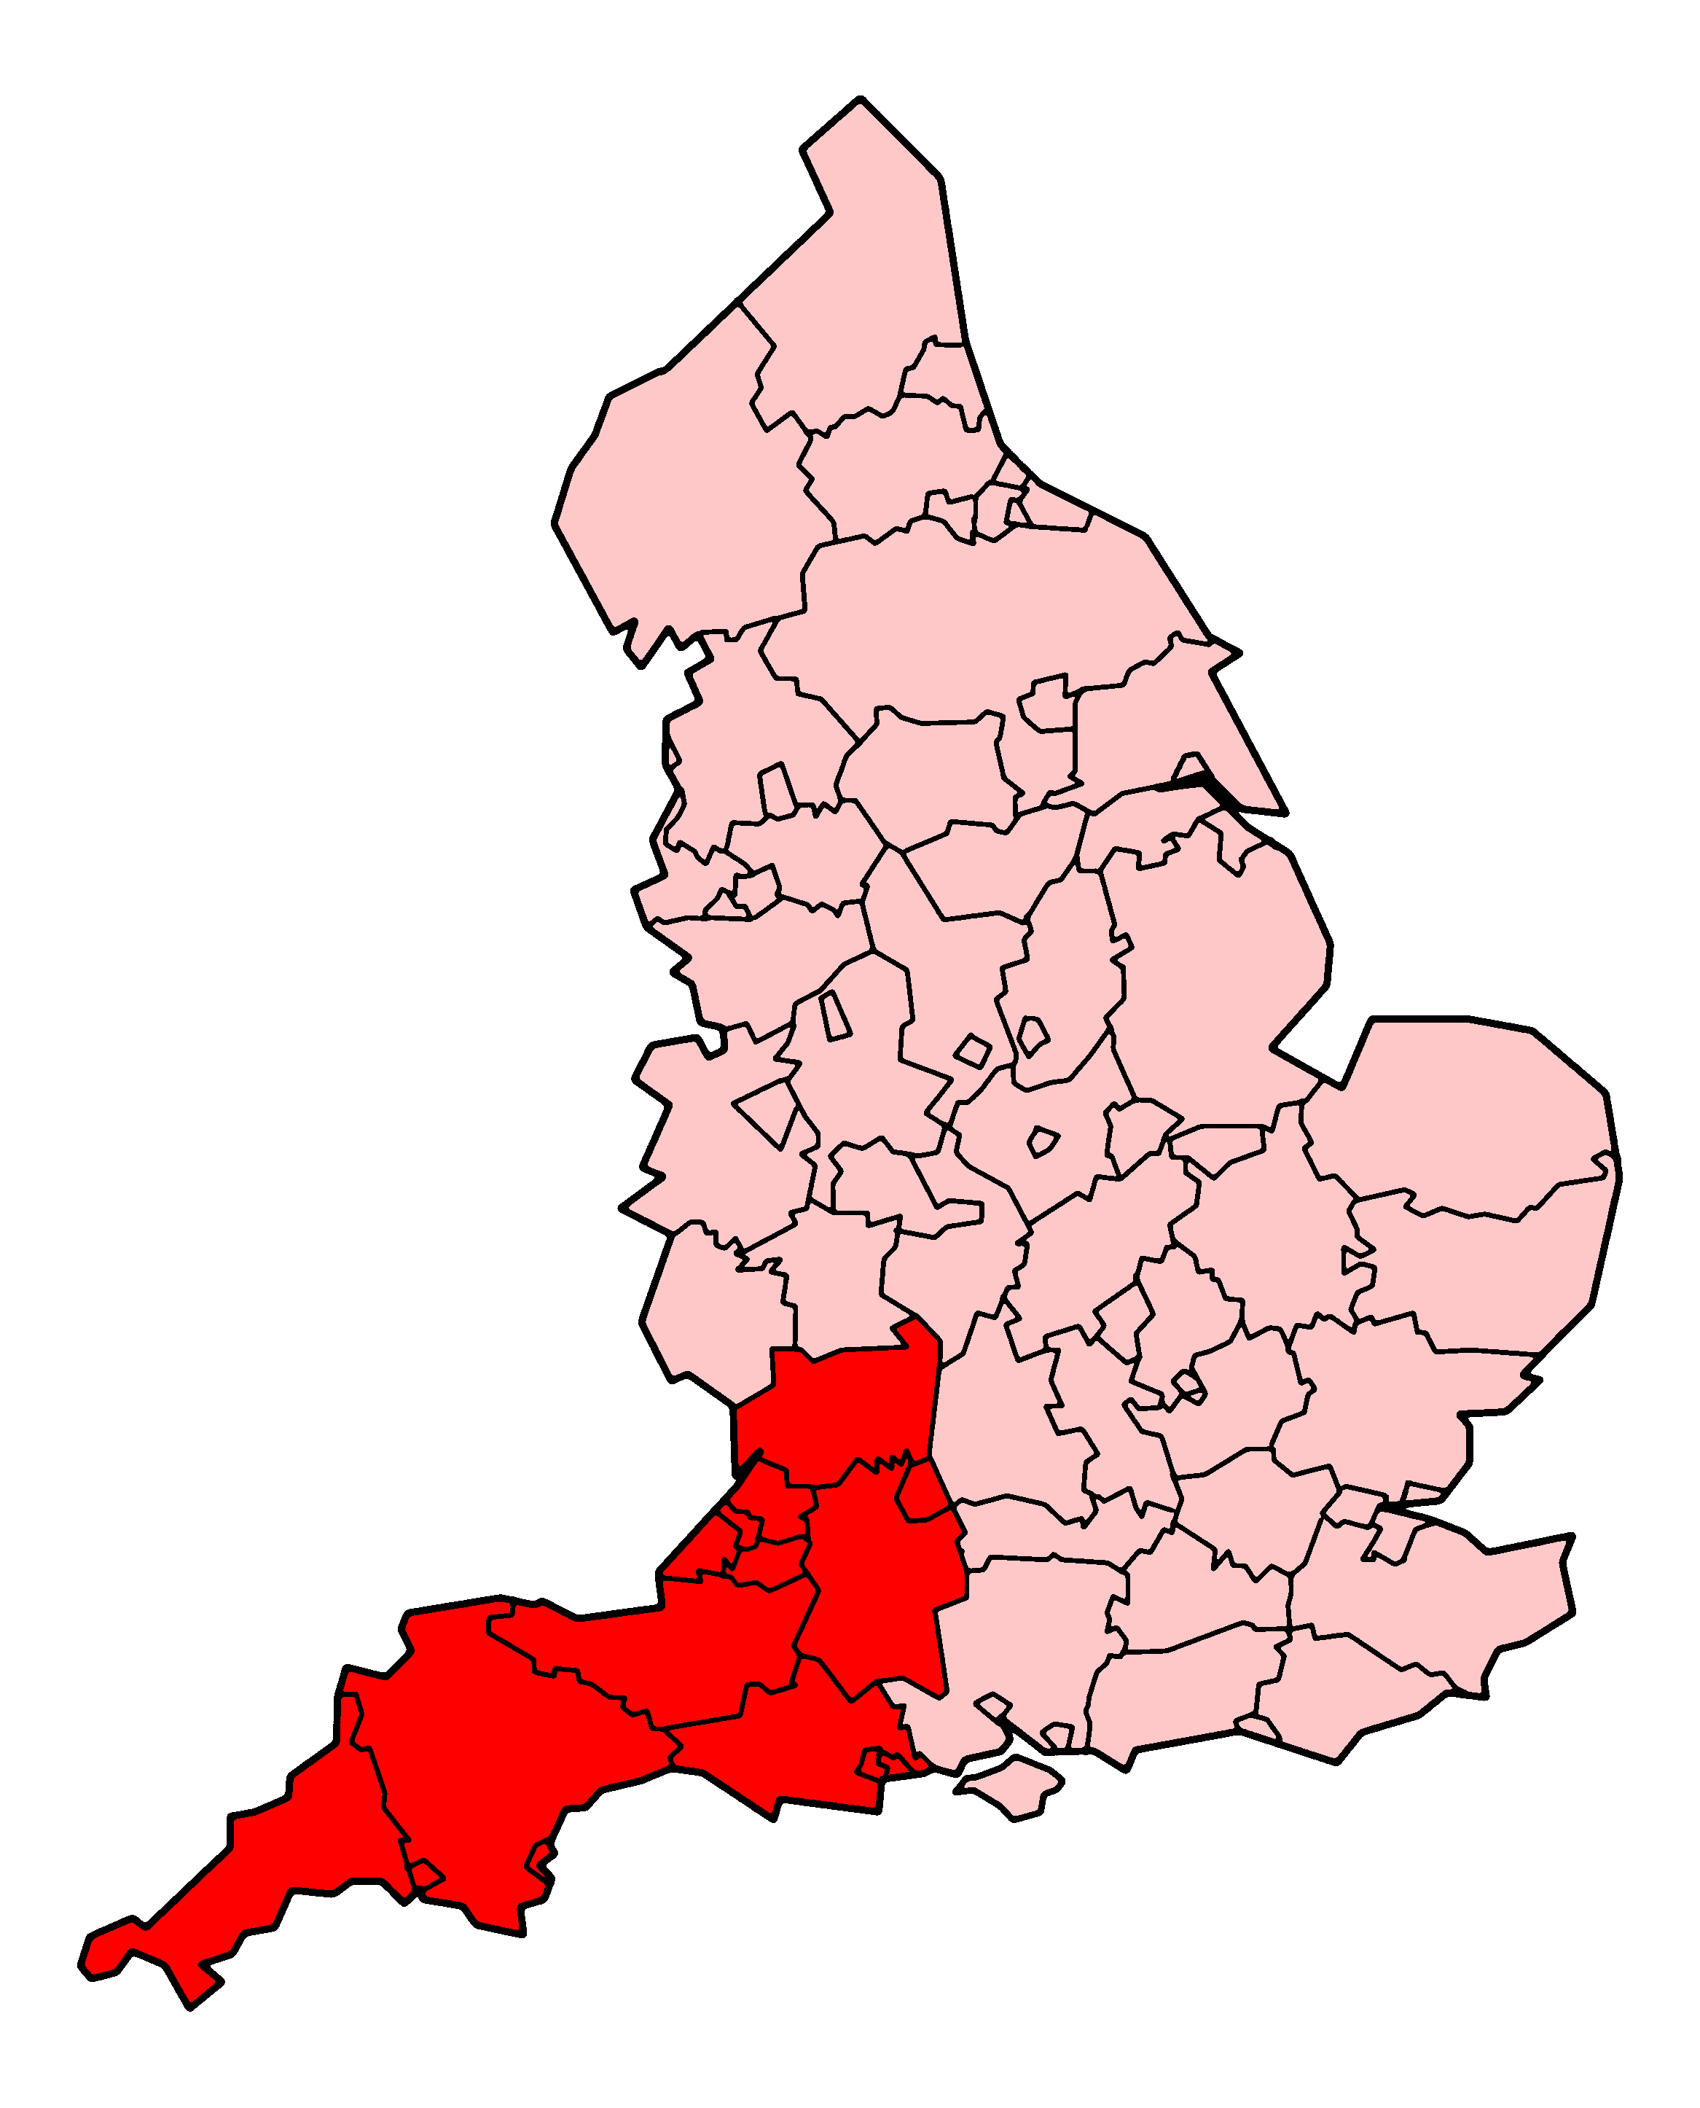
About SWAST
SWAST service provisions cover 20% of England and employ over 6000 staff members, ranging from Paramedics, Emergency care assistants and Doctors, to other frontline staff and business support functions essential for such a large service.
Our core role is to respond to calls for help and deliver an Emergency Ambulance Service to people in the South West.
Notes:
Everything every part of our organisation does is to help frontline crews save lives.

Slide 3
To deliver this, we work with partner agencies across the seven counties within our area of responsibility.

Slide 4























Who we work with
13 Local Authorities
5 Fire & Rescue Services
5 Police forces
Plus neighbouring services in areas that surround our patch
Notes:
Trying to meet the needs/requirements of so many organisations is a challenge.

Slide 5
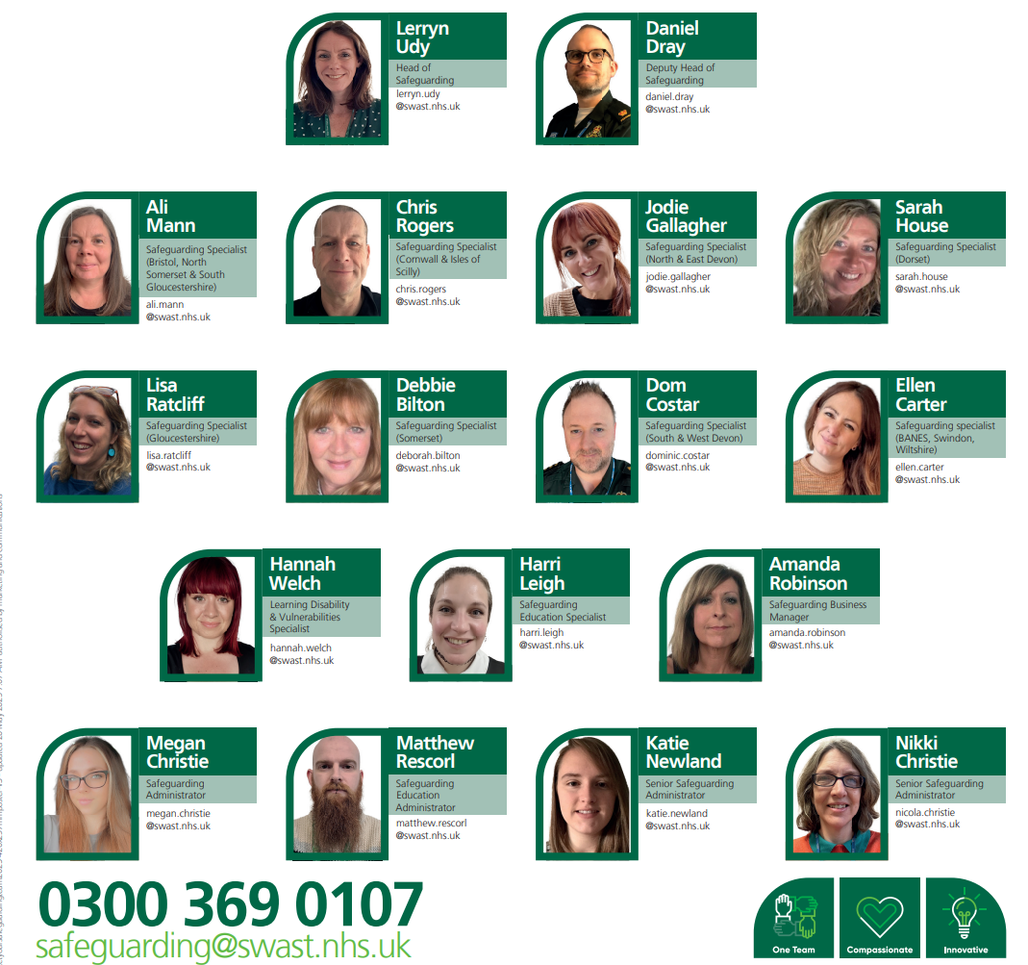

Slide 6
Since April 2024…
Increased our team capacity from 2 Safeguarding Specialists and 3 Business Support Staff, to a team of 9 Safeguarding Specialists, as well as a Head of Safeguarding, supported by a Deputy, and a specific Learning Disabilities and Vulnerabilities Lead.
We also have a specific Training function within the team, who provide safeguarding training across the organisation, seeking to embed learning from reviews.

Slide 7
Our team has vastly varied experience:
Over 100years of Paramedic experience
Nurses from diverse backgrounds including Mental Health
Occupational Therapist
Social Worker
Teacher
Midwife
Health Visitor
Detective specialising in Child Abuse and Domestic Abuse
Royal Air Force Paramedic
Notes:
Try and draw from that experience to shape our business.

Slide 8
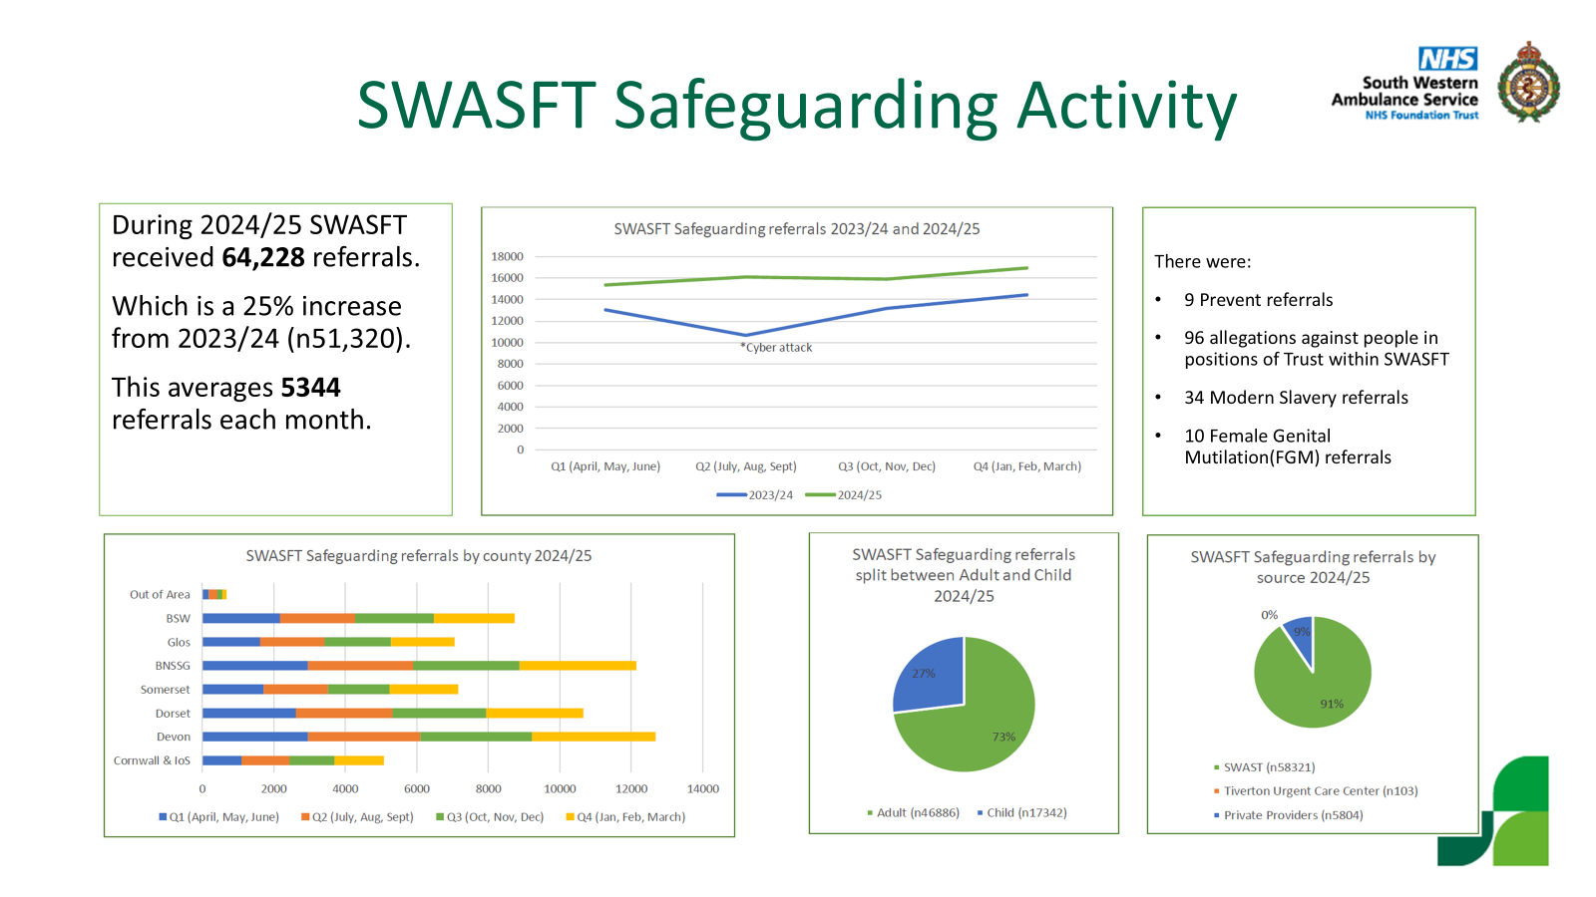
Notes:
Nearly ¾ are adults, and Devon is our busiest area.

Slide 9
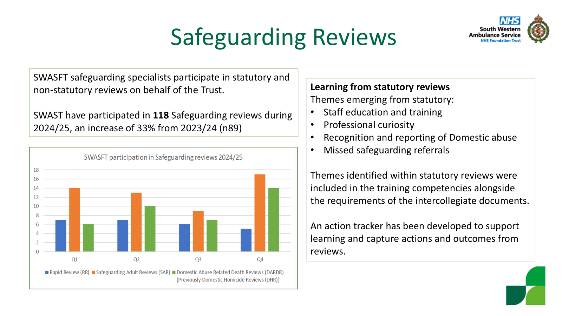
Notes:
Considerable increase in involvement in safeguarding reviews, this continues to increase. Also have clear plan to embed learning.

Slide 10
Referrals
We are now receiving over 6000 safeguarding referrals per month.
In order to reduce the delay on sharing this information with the Local Authority, DocWorks have developed a system on our behalf which went live on 13/01/2026.
The purpose of this system will be for all referrals from frontline crews to be sent directly to the LA to reduce delay in sharing of information.
Notes:
Right care, right person, this is about the service user getting the support they need.

Slide 11
Overview of the New Docworks Safeguarding System
Key benefits include:
Improved Data Quality: Mandated forms ensure consistency and completeness of information.
Enhanced Interoperability: The system mirrors the layout of partner organisations’ forms, supporting smoother collaboration and data sharing.
Automated Referral Routing: The system intelligently identifies the appropriate local authority or service, ensuring that safeguarding, care needs assessments, and fire risk referrals are sent to the correct destination.

Slide 12
What else has improved?
Across all seven counties, we now regularly attend Safeguarding Boards, Child Death Review meetings and Early Response Meetings, Domestic Abuse Related Death Reviews, CDOPs, as well as multiple requests for Professionals meetings, strategy meetings, and more.
We complete CDR reports, IMR’s, statements for Coroners Court
We have the ability to review our safeguarding referrals.
A new Child Death Policy has been written and implemented.
Notes:
In terms of good news stories, this is where we have various. As with a lot in SG, in can be hard to quantify how many people are safer as a result of actions we have taken, but internally we have seen some positive changes that have been quantifiable, such as staff retention, increase in confidence/knowledge (rise in referrals), verbal acknowledgment of an increase in support.

Slide 13
What else has improved?
We deliver Safeguarding Specific training to our frontline crews and our call handlers,
We have a dedicated duty phone line which is manned 24/7 to provide live safeguarding advice to anyone in the organisation.
We complete Safeguarding Supervision with our staff when they need support.
We held our first SG Conference in 2025.
We are developing a portfolio of 7min learning across a range of subjects.
Quarterly newsletter produced internal to SWAST.

Slide 14
What else is coming?
A review of our Domestic Abuse Policy, with changes to how we engage victims of domestic abuse and signpost them to support.
New community of practice meeting/ work with care home providers.
Focus on Making Safeguarding Personal.
Developing a network of local Safeguarding Champions.
Improvement to the way we record SG cases we have involvement with and the way we flag vulnerable people or people at risk of harm.

Slide 15
Community of Practice
Meeting quarterly
Purpose
To share learning, best practice and to encourage reflection in practice when working with care home providers and South Western Ambulance Service NHS Trust (SWAST).
To develop a shared repertoire of resources: experiences, stories, tools and ways of addressing recurring problems.
To consider national and local improvement and policy directives.
To provide peer support.
To promote discussion and professional challenge.

Slide 16
Questions

